Slide 1
The Power of APIs with Apigee Edge
Vidya Ravindran
ravindranv@google.com

Slide 2
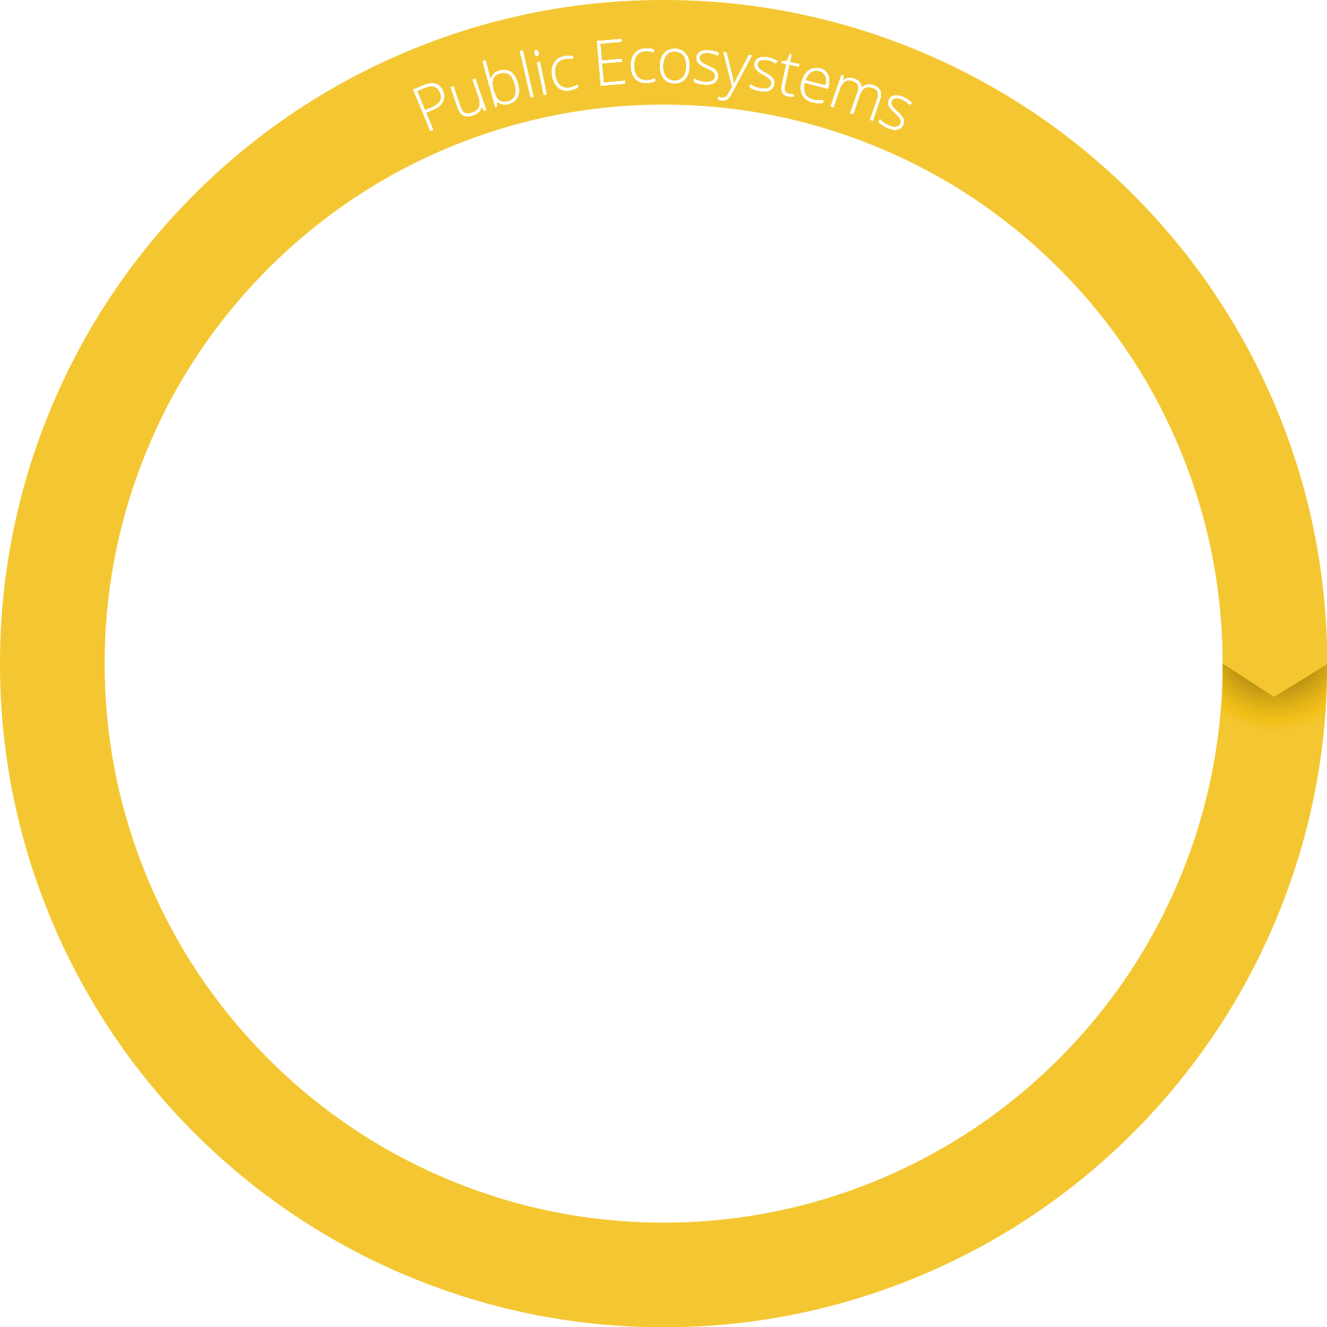

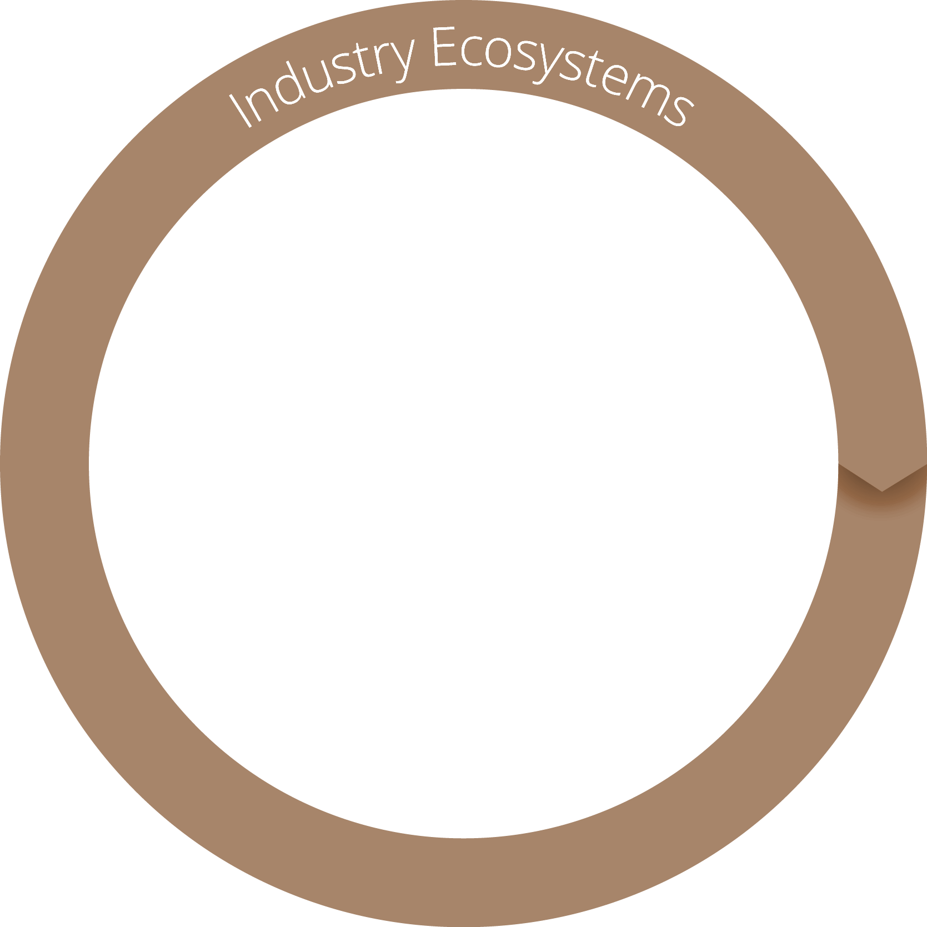

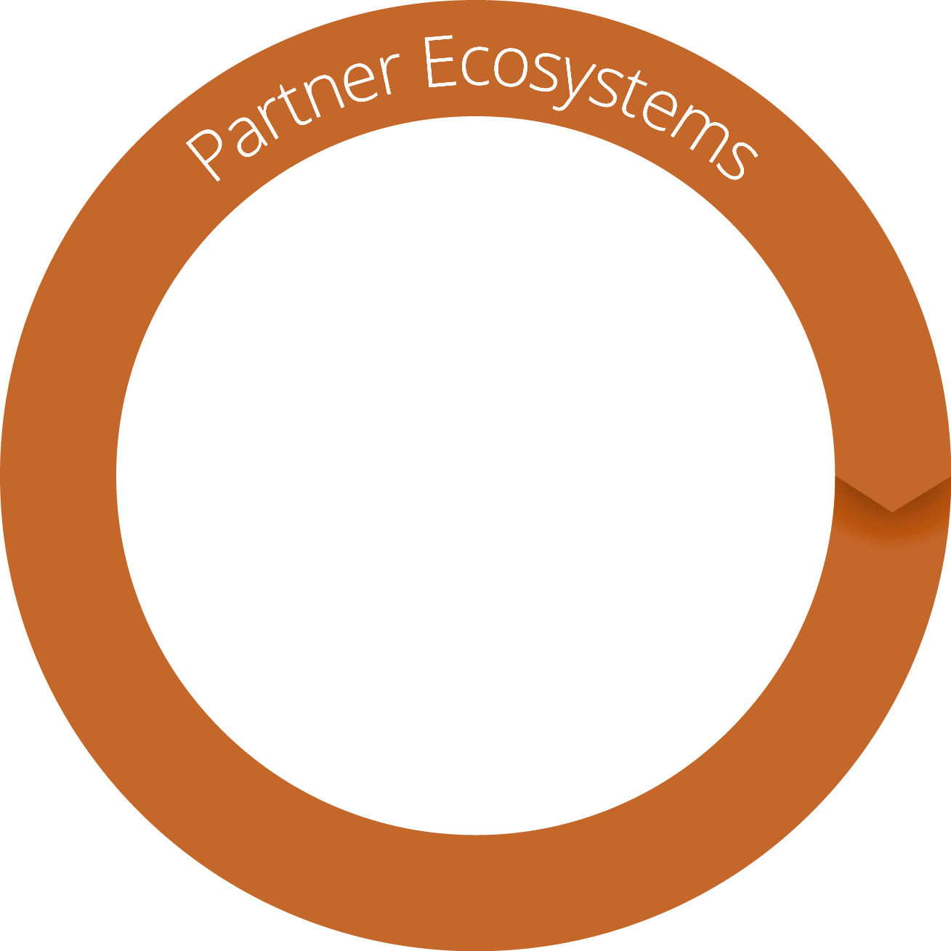
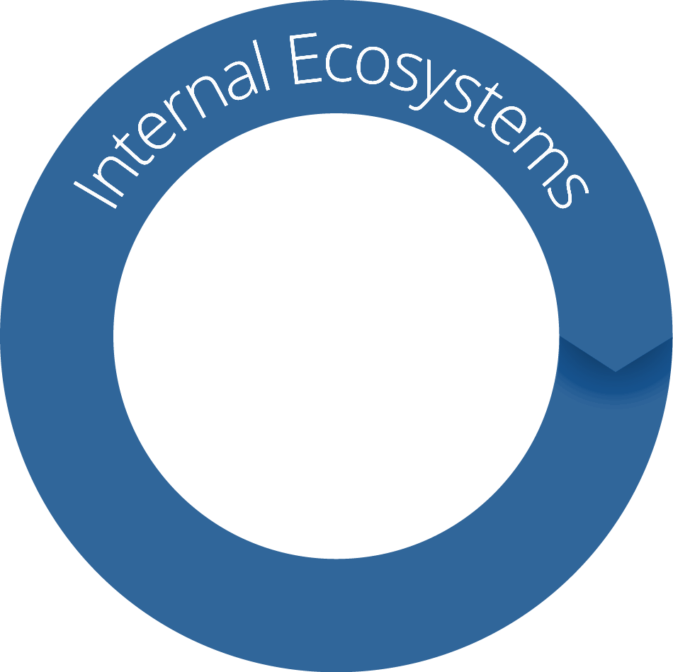
Every business is building a digital platform to create or join an ecosystem

Slide 3






Mobile Retail | Personalized Experiences | Value added services
Ecosystem Partners | Omni-Channel | Mobile Apps
New Customer Expectations

Slide 4




Retail Ecosystem
Automotive
Wearables
Mobile & Tablet Apps
Store
APIs
Retail System of Engagement Platform
APIs
CRM
ERP
Data Lake
Partners
Shipping

Slide 5



Retail Use Cases
Service & Loyalty
Increase customer satisfaction with omnichannel engagement
Reach & Revenue
Innovation
Increase revenue growth through mobile
Better service with in-store kiosks and omnichannel engagement
Efficiency
Establish digital excellence & monetize service to other grocers
Consolidate web and mobile for greater agility
Drive more customers to stores through mobile
Increase loyalty with personalized digital loyalty program
Modernize IT, improve reliability, scalability, supply chain efficiency
Reduced time-to-market enables initiatives not previously possible
Increase reach by adding more partners to ecosystem
Improve customer experience for member shoppers

Slide 6



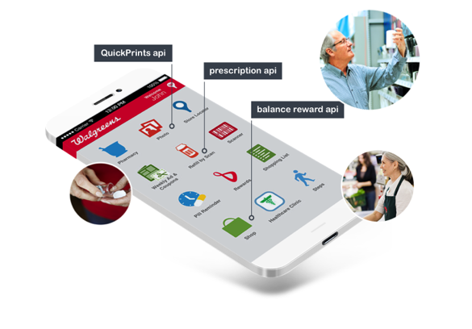
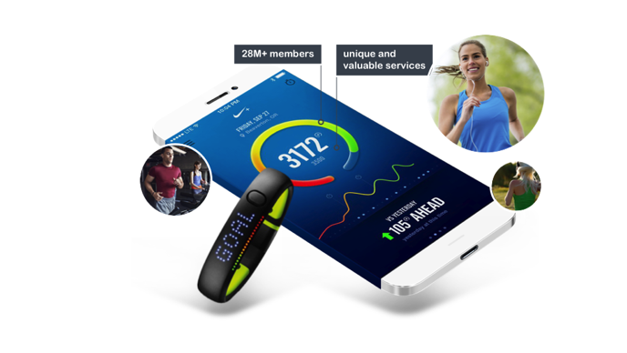

Retail Use Cases
Use Case: B2C
Walgreens exposes APIs to developers who created the Walgreens mobile app
Quick Prints API enables consumers to print photos at nearest Walgreens through Walgreens mobile app
App users spend 6X average in store
Use Case: B2B | Strategic Partners
Nike exposes fitness information as APIs to over 75 strategic partners
Nike’s strategic partners incorporate APIs into their apps faster and easier through Nike’s developer portal
Created a new way to increase loyalty
Use Case: B2E
Clienteling app for sales associates helps personalize customer service with previous sales information, recommendations, and ordering
Deployed in 450 stores
Huge improvement in customer experience

Slide 7

A Digital Business Needs Three Ingredients
CLOUD
APIs
Machine Intelligence

Slide 8
Digital Value Chain is the engine of transformation
Customers
Apps
Developers
+
Partners
APIs
API Teams
Services

Slide 9
... letting you adapt faster
Customers
Apps
Developers
+
Partners
APIs
API Teams
Services
Connected experiences
New or modernized APIs
Multiple, hybrid environments
weeks
days
months

Slide 10
All digital value chains are powered by APIs
CRM Data
Mobile
Cloud apps
Product Catalog
Customer
APIs
Pricing
Partner apps
Packaged apps
Payment Processing
Partner
100s apps
1M+ devices
TB+ data
1000s services
Partner 1
Internal apps
Shipping
Employee
Partner 2

Slide 11
API platform is critical to building a digital platform

Slide 12
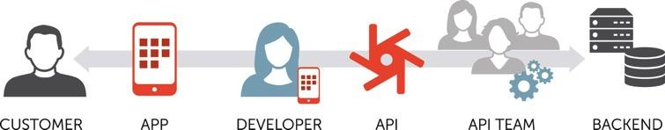
An API Platform delivers...
Adoption
Scale
Control
of public, partner and internal APIs via self service
100s apps
1M+ devices
TB+ data
1000s services
of APIs across multi & hybrid clouds via transparency
2 pizza team
Self service
Visibility
CI/ CD
Agility
Polyglot
Agile, scrum
Security

Slide 13

Transform from Silos to Enterprise-wide Services
Governance Team manages global policies around identity, fraud, security and other compliance policies. All departmental APIs automatically consume these services.
Federated Identity
Data Signatures
Fraud Detection
Global
Governance Processes
Traffic Management
Role Management
Transaction Auditing
Departmental Teams focus on their API mediation, consumption capabilities and departmental governance measures.
Inventory
Loyalty
Marketing
Apigee Federated Architecture
Account Management
Account Management
(account identity)
Line of Business
Store/Warehouse Inv
Loyalty Management
(API services)
API
Consumers
Order Inventory
Promotional Mgmt
(API activities)
Omni-channel mediation of APIs is supported by consumer subscribing to Developer Services across all departmental services.

Slide 14














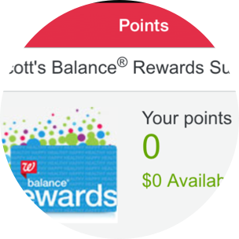












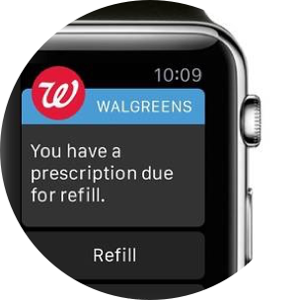

Expanding through digital journey
Security
Visibility
Scale
Speed
Onboarding
Flexibility
Platform
Security
Visibility
Deliver world-class digital experiences with 100+ API partners
Speed
Onboarding
Program
Business – IT alignment around creating digital products & experiences
Security
Speed
Project
Balance® Rewards API
Business-driven ad-hoc digital projects
Photo Prints API
Prescription API
Scheduler API
Photo Prints API

Slide 15


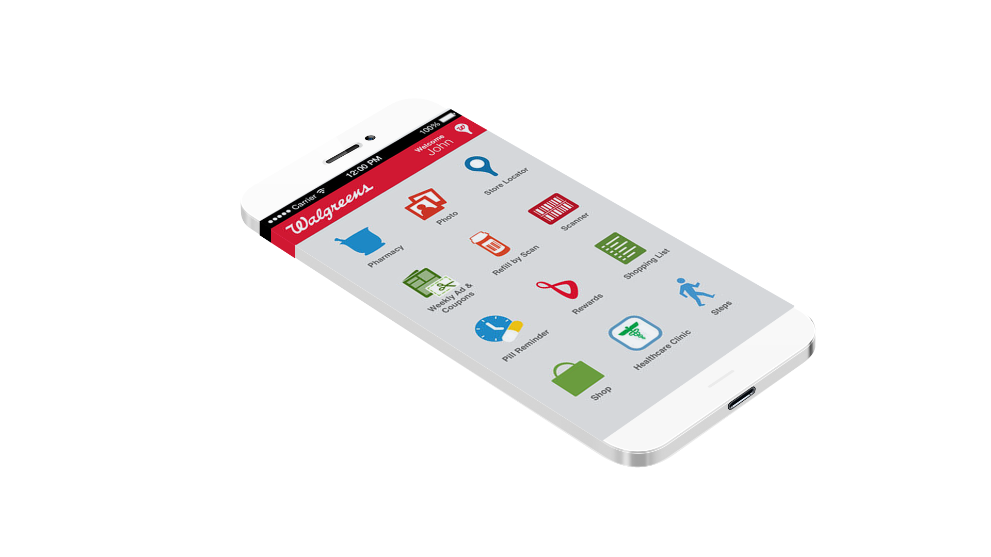


APIs Deliver Business Results
6x | More spent by customers who shop store + mobile + online versus those who shop store-only
41% | Percentage of 2.0 million digital visits per day from apps
>1 Rx/sec | Number of prescriptions per second filled from a mobile device
40M | Number of patients who access prescriptions from 3rd party apps
100+ | Number of partners building on these APIs

Slide 16
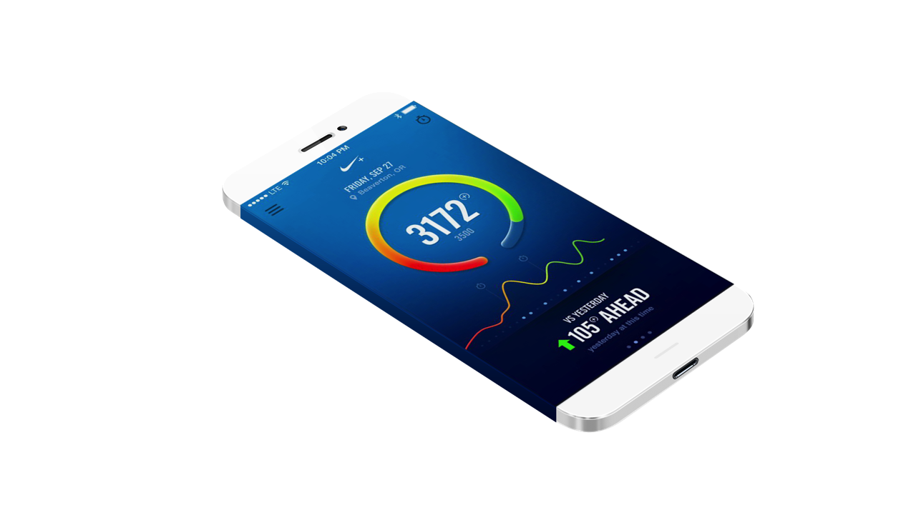


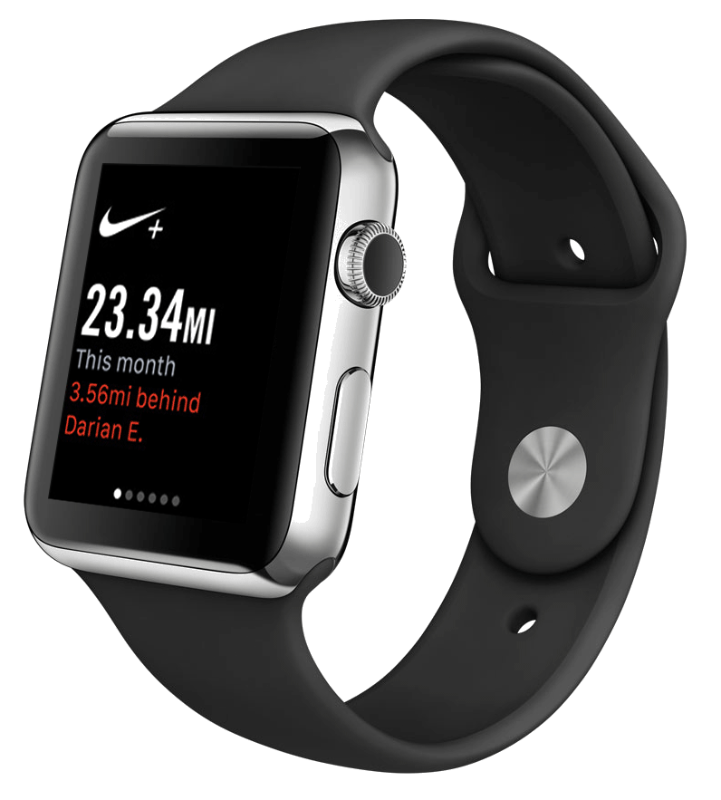


Nike
28M+ members
unique and valuable services
60% increase in revenue
Profits up 57%
Doubling their market cap

Slide 17

Abercrombie & Fitch
Leading global specialty retailer of high-quality, casual apparel for men, women and kids
Needed to simplify partner integration to extend their ecosystem and add partners to their loyalty program app
Managed cloud deployment with internal and partner APIs

Slide 18



Ebay Enterprise
Leading provider of commerce technologies, omni-channel operations, and marketing solutions
Needed greater security, API visibility for order management, payment services, and customer service
Managed cloud deployment with internal APIs
Greater scalability and security with improved ability to add more customers and revenue with minimal risk

Slide 19


Home Depot
World's largest home improvement specialty retailer with stores
Wanted to grow online commerce substantially through mobile and needed more flexible RESTful infrastructure
Managed PCI cloud DN deployment with internal and partner APIs
Greater flexibility to expand mobile and online commerce and increased reach and mobile mindshare with partner API

Slide 20



Burberry
Markets luxury apparel and accessories in the fast moving fashion market
Wanted to improve customer interaction and experience, better understand customer journey and how to increase loyalty
Managed Edge cloud DN deployment with internal and partner APIs. Cloud Insights for journey analysis and recommendations
Clienteling app for sales associates helps personalize customer service. New breed of app, Artofthetrench built with BaaS.

Slide 21
Why Apigee?

Slide 22
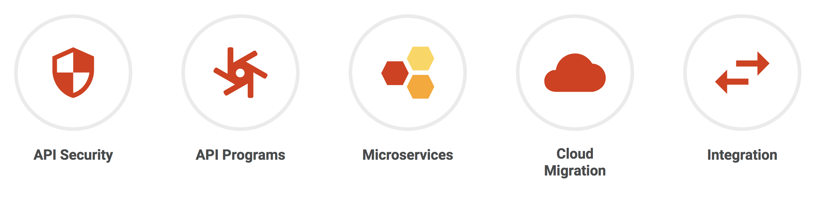
API use is growing...

Slide 23

API management platforms must support the entire Digital Value Chain
End Users
Applications
Developer, Partner
APIs
API Team
Legacy Backend
Microservices
Visibility
Security
On-boarding
Scale
Agility
Proprietary and confidential

Slide 24






...and “bridge the gap”
Connected Digital Experiences
>
Days
Customers
Employees
Partners
>
>
Apigee Edge
Pace of change
Speed of Innovation
Scale
Mission Critical
>
ESB / Integration
Years
CRM, ERP, etc.
SOA
Database
Data Warehouse
Data Lake
>
>
SYSTEMS OF RECORD

Slide 25
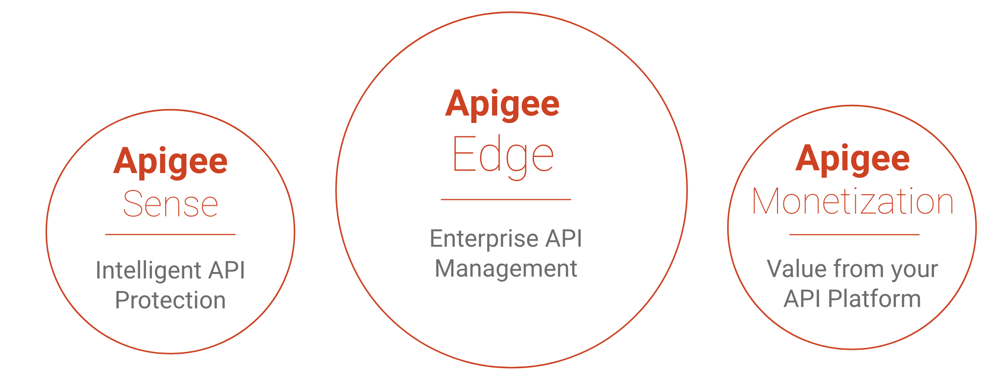
Apigee Products

Slide 26
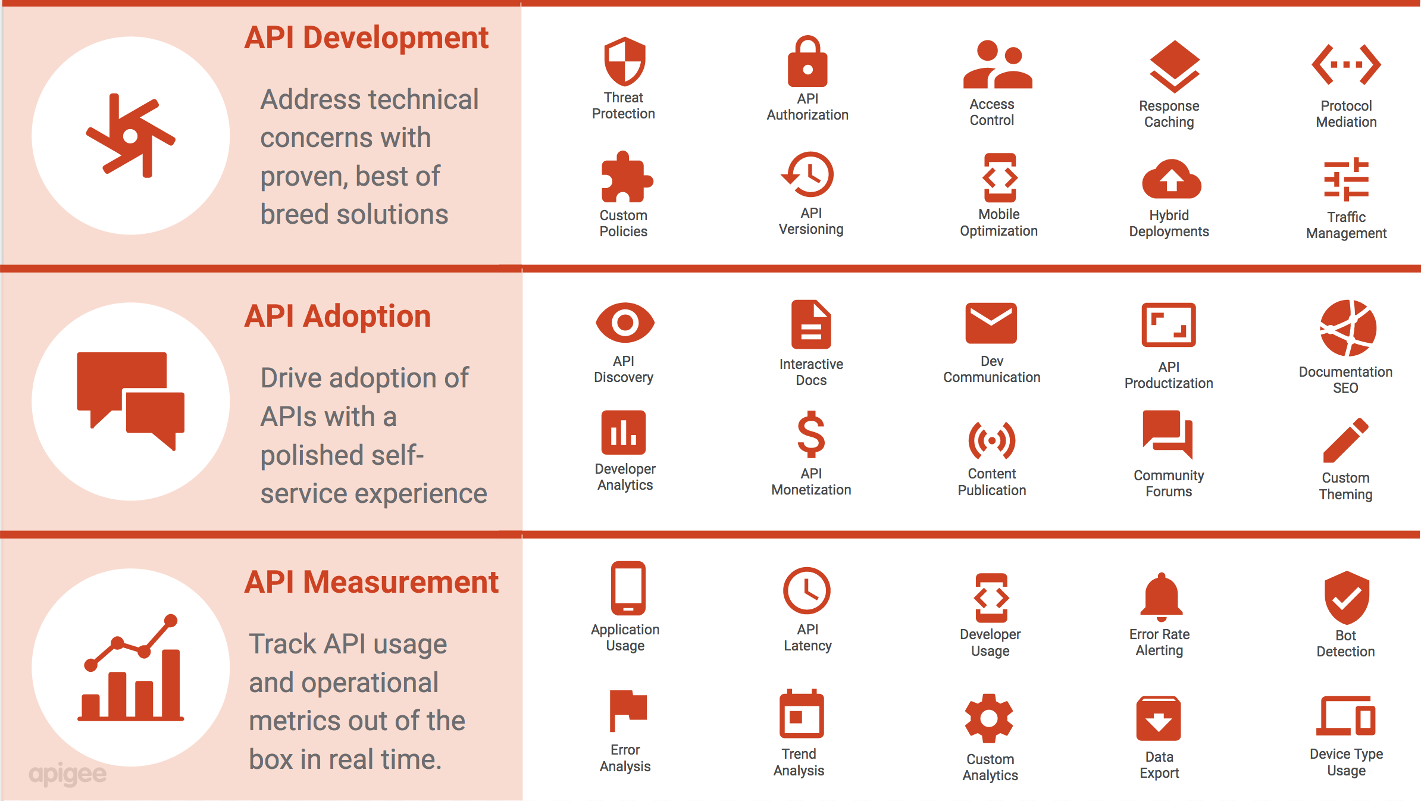
Functions of an API Platform

Slide 27
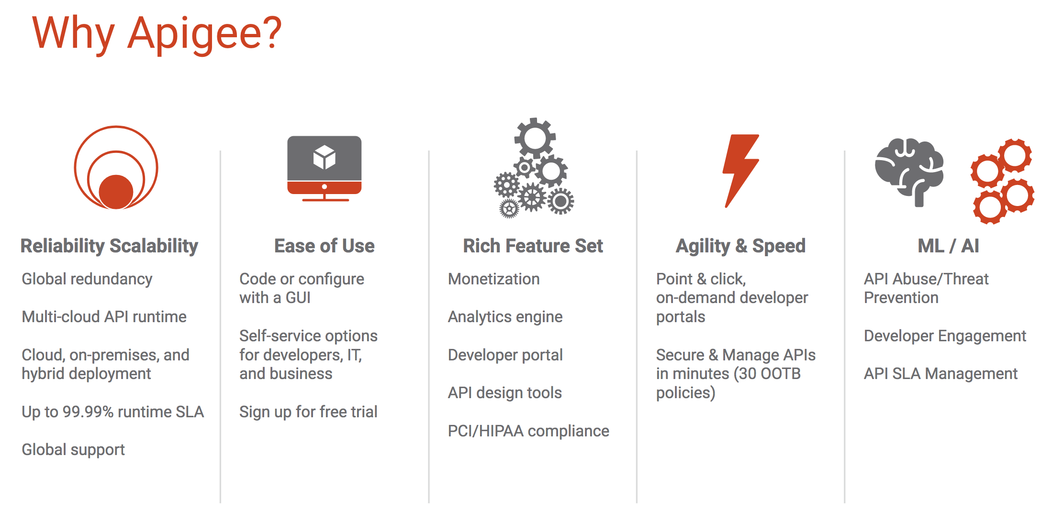

Slide 28


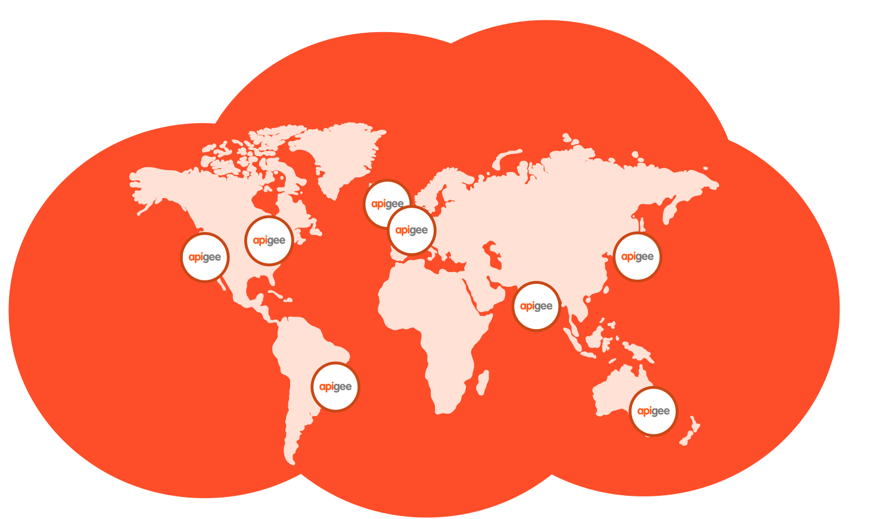
Apigee Edge: History of Success
BUSINESS SPIKES – NO PROBLEM
QUICK START BUSINESS APIs
80,000+
Banking
Identity
Health
Commerce
peak API traffic per sec
ALWAYS ON
YOUR CHOICE, NO LOCK-IN
99.999%
Multi-Cloud, Hybrid, On-Premises
API availability
27
12+
2.7B+
availability zones
regions
transactions/day
Notes:
Talking points
Compare 50k peak api traffic per second to
28k peak tweets per sec (Twitter)
11k peak transactions per sec (Visa)
At 99.999% availability
-- expected downtime per year for apigee is 5 minutes
For comparison - At 99.7% availability
-- expected downtime would be 1576 minutes

Slide 29
































































































Our customers
Notes:
Updated 4/11/18 with Zain
Updated 4/10/18 with PwC
Updated 3/19/18 with BazaarVoice and latest Citrix logo
Updated 3/12/18 with Cambridge Assessment
Updated 2/9/18 with Flex
Updated 2/7/18 with HP and West Corp.
Updated 1/25/2018 - removed ITV
Updated 1/12/2018 - removed HCSC
Updated 11/29/2017 with JS Bank
Updated 11/22/2017 with Cleveland Clinic
Updated 11/10/2017 with MINSAL
Updated 11/2/2017 with Shutterstock and Passio
Updated with new layout 10/26/2017
Updated 10/17/2017 with Rush University Medical Center
Updated 9/15/2017 with Plantronics
Updated 8/30/2017 with latest M&S logo & latest Shutterfly logo
Updated 8/30/2017 with OFX
updated 8/16/2017 with SFO
updated 8/7/2017 with ABN AMRO
updated 8/1/2017 with Arity
updated 7/31/2017 with OpenGov

Slide 30
Why Apigee Edge?

Slide 31
Apigee Edge: History of Success
BUSINESS SPIKES – NO PROBLEM
QUICK START BUSINESS APIs
80,000+
Banking
Identity
Health
Commerce
peak API traffic per sec
ALWAYS ON
YOUR CHOICE, NO LOCK-IN
99.999%
Multi-Cloud, Hybrid, On-Premises
API availability
27
12+
2.7B+
availability zones
regions
transactions/day
Notes:
Talking points
Compare 50k peak api traffic per second to
28k peak tweets per sec (Twitter)
11k peak transactions per sec (Visa)
At 99.999% availability
-- expected downtime per year for apigee is 5 minutes
For comparison - At 99.7% availability
-- expected downtime would be 1576 minutes

Slide 32




Apigee covers the entire API lifecycle
Design
Monetize
Develop
Analyze
Secure
Edge
Monitor
Publish
Scale

Slide 33
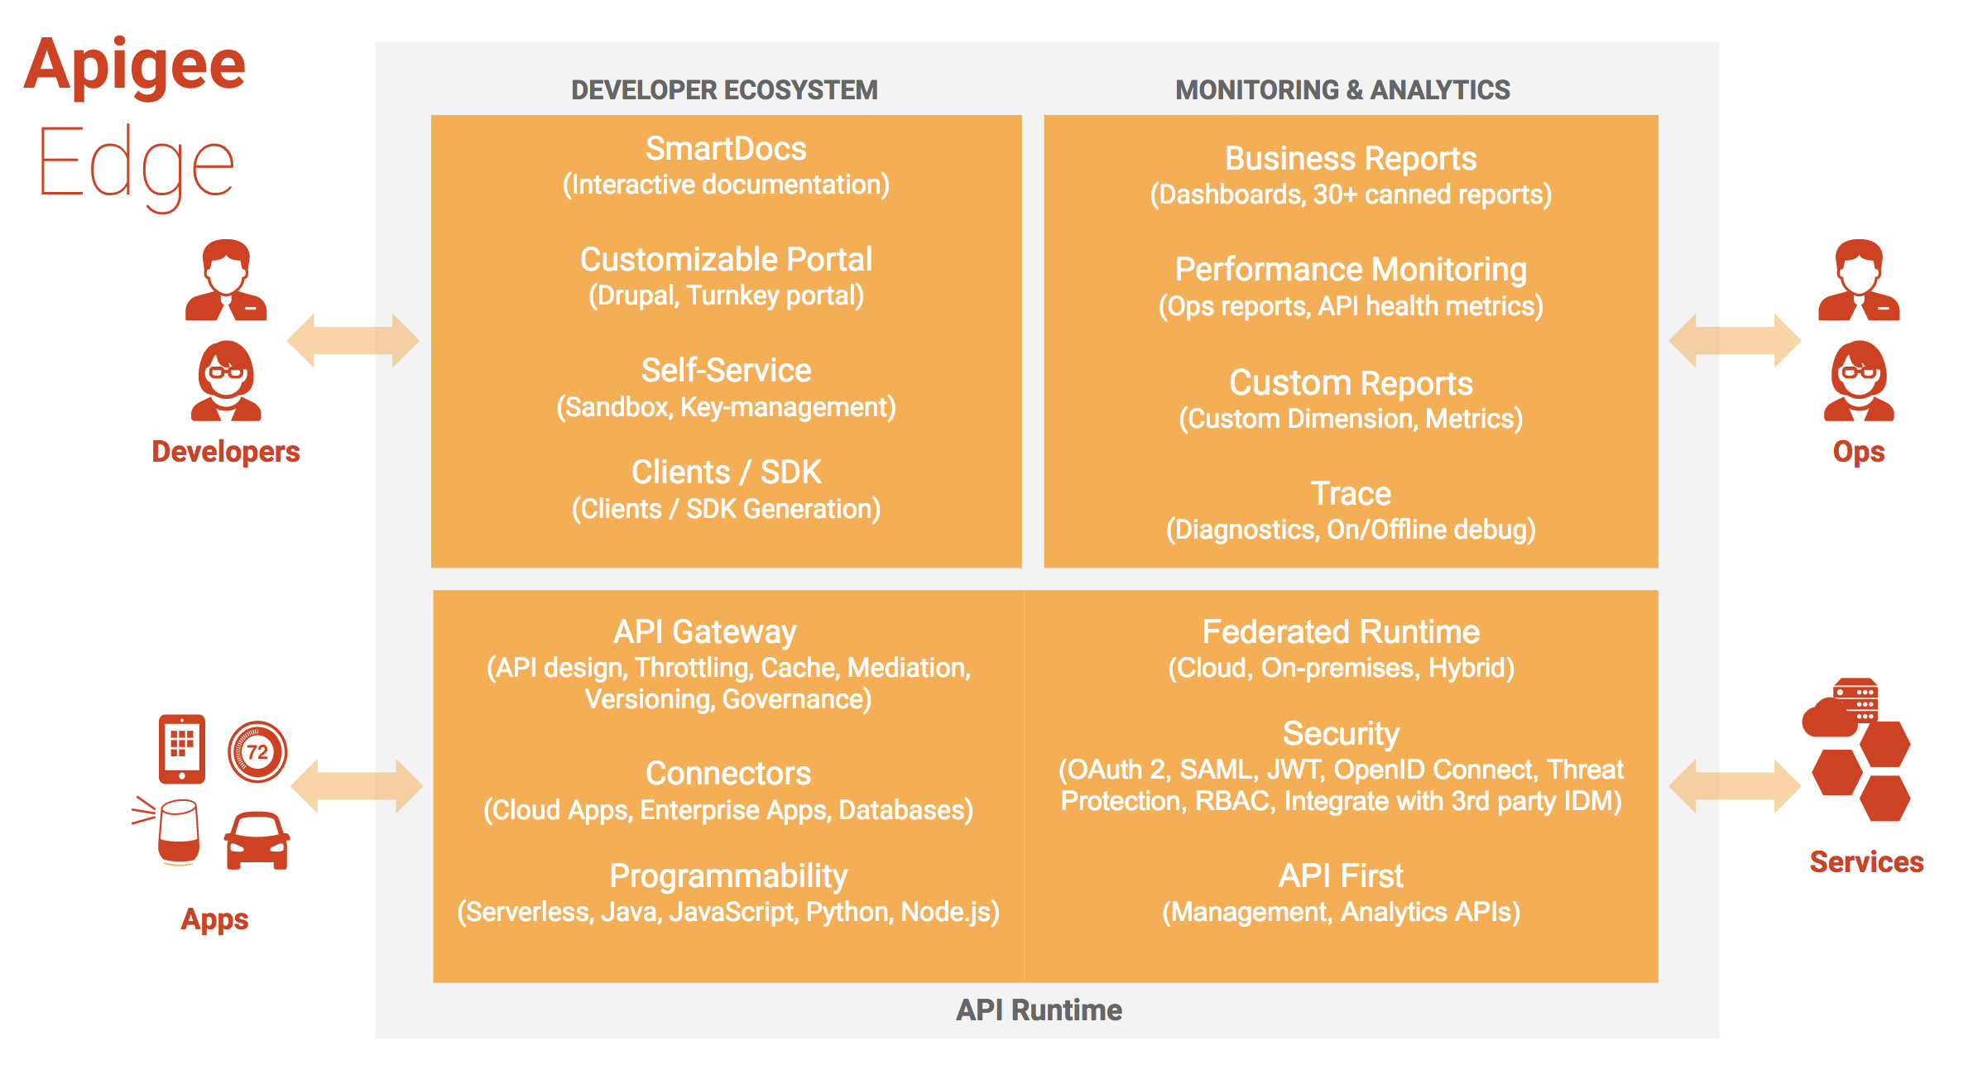

Slide 34
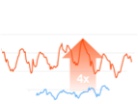
Apigee Edge - Built for APIs, Built with APIs
Self-Service
Alerting and Monitoring
Authentication
and authorization
Mission Critical Auto-Scaling
Flexible Deployment
27 Availability Zones
14+ Geographical locations
Developer Portals
Management UI
SDKs
Apigee Edge APIs
Management API
Analytics API
Gateway API
Gateway API
Policies
Trends
Proxies
API Usage
Node.js
Analytics Functions
Connectors
Custom Analytics
Highly Available “NoSQL” Data
Scalable Time-Series Data
Billing API
Monetization Engine

Slide 35
Complete and Unified Across the Entire API Lifecycle
Design Design first. Document Smart. Full support for Swagger 2.0
Monetize
Flexible rate plans
Internationalization support
Usage tracking
Limits and notifications
Develop
Configuration: Over 30 ready-to-use & configurable policies
Code: Built-in support for Node, JavaScript and
Java extensibility
Analyze
Complete visibility– from app end to backend
Automatically and continuously collect all API-traffic data out of the box
Secure
End-to-end security
Threat protection
Access control
Simple OAuth implementation for your APIs
PCI and HIPAA compliance
Edge
Monitor Centralized control, decentralized development
Multi-tenant architecture
Billions of API calls, including large spikes
Publish
Turnkey developer portal
Scale
Self-service
State @ scale
Flexible deployment
Notes:
Main Point
Apigee Edge addresses your needs across the entire API lifecycle
Script
Apigee Edge addresses your needs across the entire API lifecycle – from designing APIs to building them to scaling your API program and finally monetizing your APIs. Apigee Edge satisfies a number of your needs that would otherwise be very time consuming and costly to build and operate at scale.
Let me show you how Apigee Edge supports you throughout the API lifecycle. Apigee Edge offers a very broad product footprint – we won’t have time to cover all the needs, however, we’ll cover a few salient ones.

Slide 36
Design
Monetize
Develop
Analyze
Secure
Edge
Monitor
Publish
Scale

Slide 37
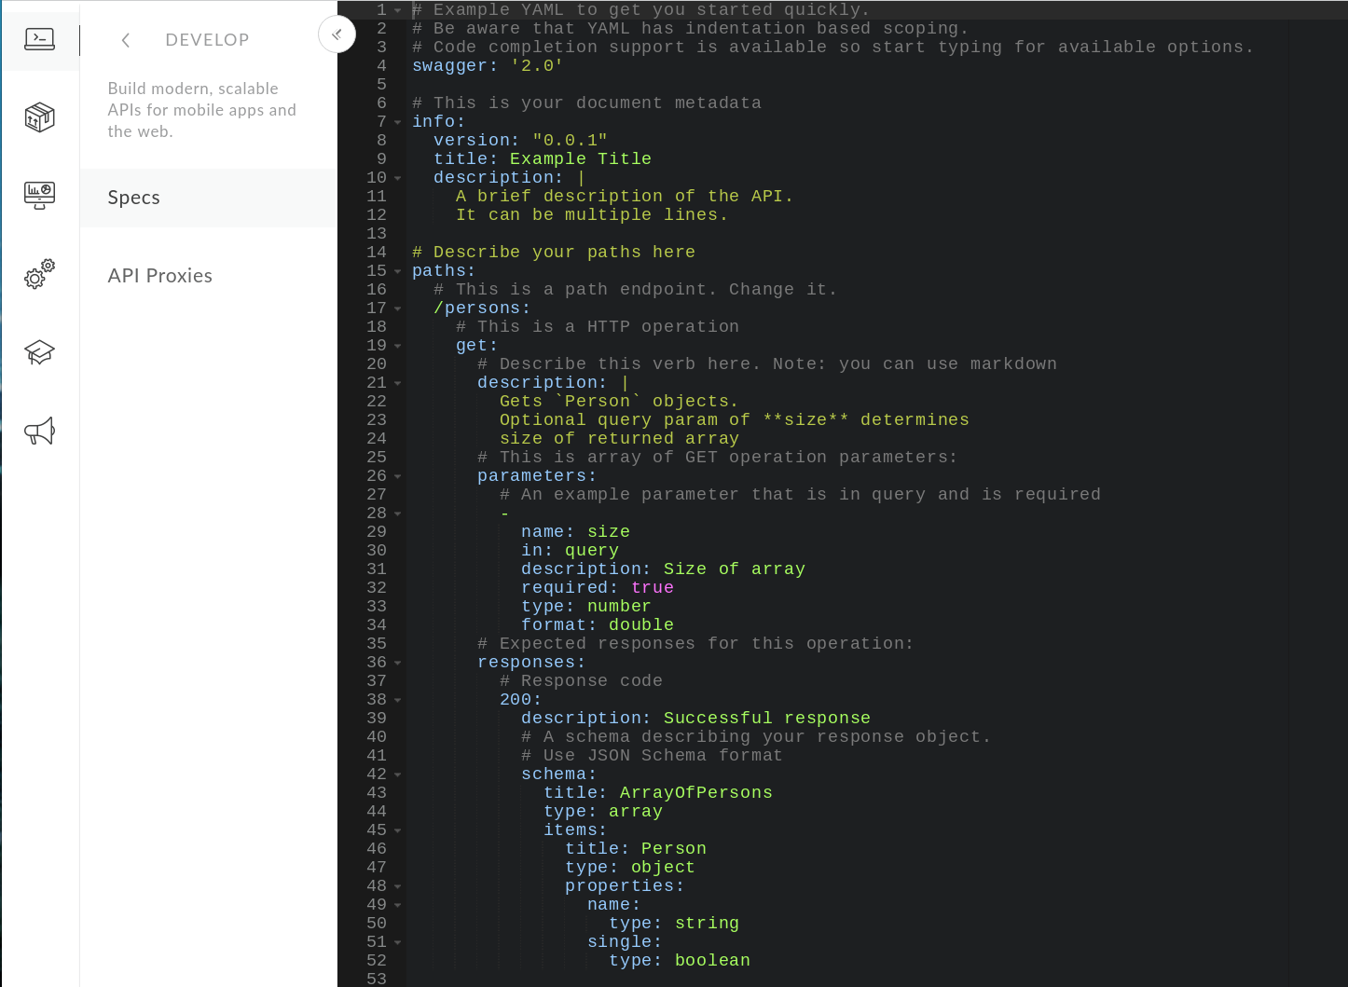

Build More Consumable APIs
Notes:
Main Point
Apigee Edge enables you to build more consumable APIs with a design-first approach
Script (needs to be verified)
APIs are built for app developers to consume. Its imperative that your APIs are useful to them – built in a way that makes their apps shine. If you build your APIs in a vacuum, you risk delivering APIs that don’t meet their requirements, which can result in costly and frustrating rework, and lengthy, unnecessary delays in getting your apps to market. Instead, Apigee Edge enables you to take a top down approach. You can design the APIs using Swagger and collaborate with your app developers to agree on a shape that works. You can use Smart Docs to build documentation for this API design. With this agreement in place, you can build the API knowing that they will be used. And While you’re building the API, your app developers can use mocks of the API designed and the smart docs to build their apps. With this agile approach, you increase your chances of delivering APIs and apps that make an impact, perform as expected; and deliver them FAST.
Link to Wiki
No differentiator page on Wiki
For Instance
None

Slide 38
Develop
Edge
Edge

Slide 39
Build APIs Faster
Traffic Management
Quota
Reset Quota
Spike Arrest
Concurrent Rate limit
Response Cache
Lookup Cache
Populate Cache
Invalidate Cache
Security
XML Threat Protection
JSON Threat Protection
Regular Expression Protection
OAuth v2.0
Get OAuth v2.0 Info
OAuth v1.0a
Verify API Key
Access Control
Generate SAML Assertion
Validate SAML Assertion
Mediation
JSON to XML
XML to JSON
Raise Fault
XSL Transform
SOAP Message Validation
Assign Message
Extract Variables
Access Entity
Key Value Map Operations
Extension
Java Callout
Python
JavaScript
Service Callout
Statistics Collector
Message logging
Manage interactions with API consumers and optimize performance
Secure APIs and protect back-end systems from attack
Transform, translate and reformat data for easy consumption
Extend with programming when you need it

Slide 40
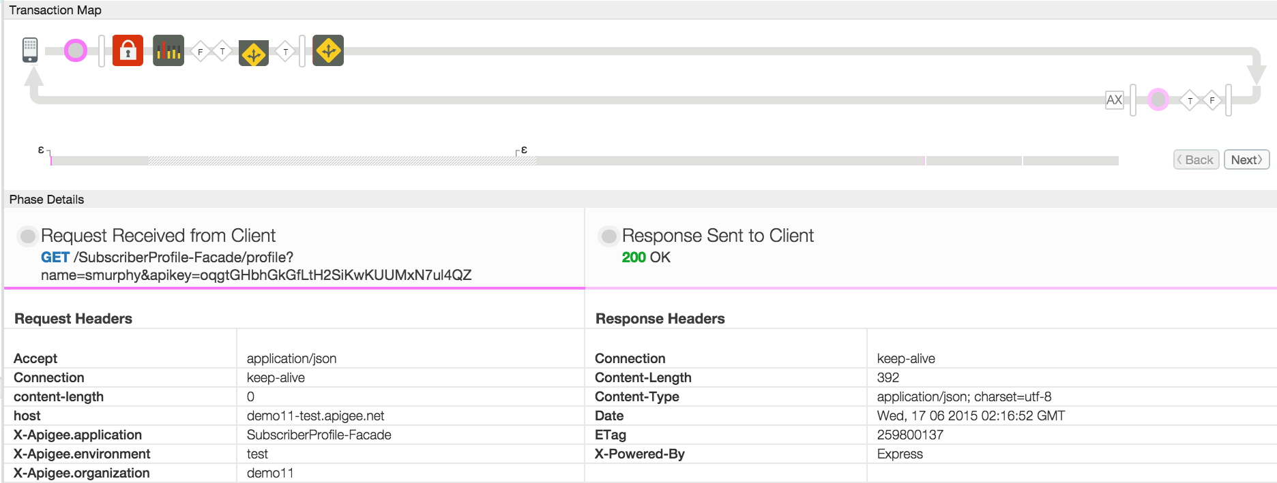
Easily Debug APIs
Trace API call flow and debug errors sooner
Notes:
Main Point
Apigee Edge provides a visual trace tool that enables you to spend less time debugging and more time creating value
Script
API proxies now are much more than simple pass-throughs with lightweight traffic management. Instead, they are now the basis for all application interactions. Therefore, its critical that you can quickly debug API proxies and understand how they operate in specific situations.
Apigee Edge provides a visual trace tool that is an API “debugger”. It enables you to quickly inspect the details of an API call through the Apigee Edge runtime engine. With the trace tool, you spend less time debugging and more time creating value.
With the Visual trace tool, you can understand the state of an API call at any point in the API call flow, inspect proxy and target request & response payloads, optimize the API call flow. You can debug the API without the need to
inspect multiple log files or write additional debug logic in the client and server. This better understand root causes and more quickly resolve app-specific issues.
Link to Wiki
https://apigeesc.atlassian.net/wiki/display/SEP/Visual+Trace+Tool
For Instance

Slide 41
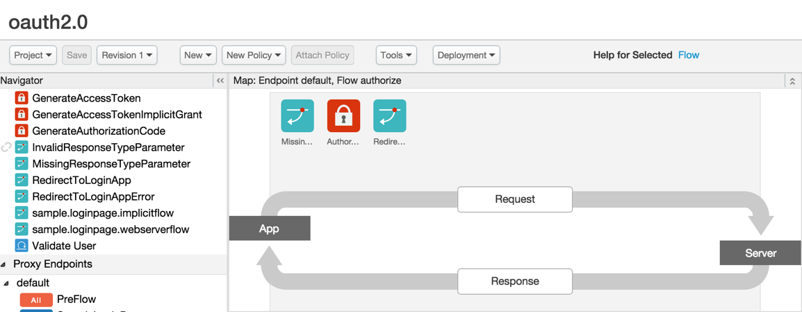
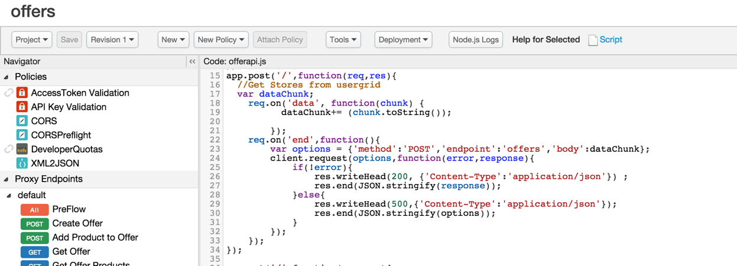
Configuration and Code
Configuration driven - extensible by code
Configuration Driven Proxy Definition
Effort
Code
Configuration
Code Driven Proxy Definition
Connections, Resources, Security, Quotas, Policies (30+ OOTB)
Complexity
Notes:
Main Point
Apigee Edge enables you to improve the productivity of your developers by empowering them to use as little or as much code as needed.
Script
You need to improve developer productivity, empower them to build APIs quickly and extend them to do anything advanced. We make it easy for developers to create proxies by writing zero code… or little code if they chose too.Developers can quickly get started by using over 30 out of the box policies and the self-service UI to create their proxies. They can then extend those proxies with light-weight code. This presents a healthy balance between getting started quickly and supporting complex requirements.
In addition, our design-first approach leveraging open-source swagger is unique. Developers can collaborate with their peers and app developers before writing code. In addition, using Apigee 127, they can code on laptops/on-prem and deploy it on-prem or cloud. We also support multiple languages which provides more flexibility.
Link to Wiki
https://apigeesc.atlassian.net/wiki/display/SEP/API+Development+with+Configuration+and+Code
For Instance
“You [Apigee] enable us to innovate at such speed we’ve turned from an aircraft carrier to 10,000 speed boats.”, John Donovan, Sr. EVP, Technology and Network Ops, AT&T (see separate slide)

Slide 42

Enable Fine Grain Controls in the API Proxy
Segment each part of the flow, including default and non-default paths, as well as pre-flow and post-flow for both request and response.
API Proxy
Proxy Endpoint
Target Endpoint
PreFlow
Route Rule
PreFlow
Conditional Flows
Conditional Flows
Request
PostFlow
PostFlow
PreFlow
PreFlow
HTTP Service
Client
Response
Conditional Flows
Conditional Flows
PostFlow
PostFlow
Notes:
(Explain Shared Flows for customized reuse. Also explain how Flow Hooks can be used for consistent request pre-processing or response post-processing.)

Slide 43
Secure
Edge

Slide 44
Secure All Points of Engagement
User
App
Developer
API
API team
Backend
Threat Protection
Behavior Based
Signature Based
Payload Complexity
Spikes
OWASP (SQL injection, input validation, etc.)
Access Controls
OAuth2
API Keys
Products
Scopes
Quota/Spike Arrest
Logging
Self Service & SSO
IAM Integration
Prov. & DeComm
OpenId Connect
JWT
SAML
Security Governance
Global Policies
RBAC management
Data Masking
Compliance:
PCI-DSS, HIPAA, SOC1&2
Data Security
TLS
Two-way TLS
IP Access Control
Encrypted Data Store and Cache

Slide 45
Layered Security & Governance
API MANAGEMENT
Identity Mgmt & Governance
Portal
Analytics
Management Server
RBAC management
IDM Integration
Global Policies
User Provisioning
AD / LDAP
Groups
Data Security Org Boundaries
Encryption
SOC 2, PCI-DSS, HIPAA
Partners/ Apps
Backend
Data Security Two-way TLS
API key
OAuth2
Threat Protection
Access Control OAuth2
API Key Verification
IP Access Control
Logging & Auditing
Data Security Two-way TLS
IP Access Control
Logging & Auditing
Quota/Spike Arrest
SQL threat protection
JSON bomb protection
IP based restrictions
Bot Detection (on Apigee Public Cloud today)
Notes:
Main Point
Apigee secures all points of engagement from user interactions to back end systems
Bold parts
Transport, request, content
Script
Security breaches are becoming increasingly common leading to brand damage, IP exposure, and costly mitigation procedures. Consumer expectations on security and privacy of PII data have increased dramatically.
Apigee Edge provides easy to use security features for each step of the value chain. In addition, the out of the box security features embody best practices and guidelines required by PCI and HIPAA regulations. With many security capabilities - Oauth 2 to secure user and app interactions, many easy to configure and extend self-service policies and features to mitigate threats to your APIs. e.g. Rate limiting policy to protect any traffic spikes due to DoS attacks, role based access control, Mutual TLS and more – Apigee secures all points of engagement from user interactions to the back end.
Apigee Edge is (penetration) pen-tested by a 3rd party vendor. This means our private cloud customers can deploy it without further security testing required. We can provide a pen-testing report to your internal security and audit team – this not only accelerates the time to deployment but it can also save you $25-50K of pen testing cost.
Cloud customers can rely on Apigee’s expertise and experience in hosting thousands of customer APIs in our cloud and resolving any emerging security vulnerabilities. We respond to security patches in days and release it so you don’t have to worry about new security vulnerabilities.
Apigee brings years of infrastructure and service delivery partner strength such as strategic partnership with AWS. For example we have mitigated risks to customers due to security vulnerabilities such as - FREAK, HEARTBLEED, SHELLSHOCK, POODLE. All responded within 24 hours with least impact to our customer APIs and availability. We're part of AWS Advisory Council to influence their strategic direction and security features. We have a strong architecture and AWS partnership (people, process, tech) to address DDoS on Apigee cloud.
Link to Wiki
https://apigeesc.atlassian.net/wiki/display/SEP/THEME+%3A+Security (see each section under this theme)
For Instance
Apigee Edge software is trusted by hundreds of customers in Health care, Financial and Govt vertical to protect their APIs and meet their PCI, HIPAA and other compliance needs.
Retail customers including Target, Home Depot, Kohls - Financial customers like Vantiv, Firstdata, Amex; Healthcare customers like Humana, Cambia Health, HCSC and various Govt customers.
When Heartbleed, FREAK, was discovered, we were able to mitigate the vulnerability within 24 hours with no visible impact to our customer API traffic
When AWS had a hypervisor vulnerability that required 50% of Apigee servers to be rebooted automatically without notification, we were able to sustain the reboots with zero downtime.
SAP does security pen-testing on every Apigee release and we have always passed their stringent benchmark for OWASP Top 10 and SANS 25 application security standard.

Slide 46
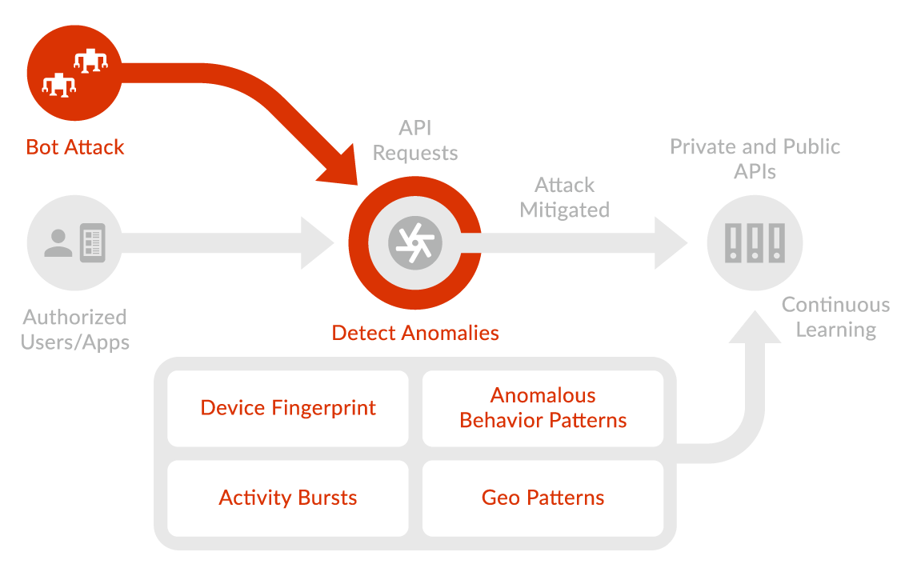
Apigee Sense
Notes:
Main Point
Apigee secures all points of engagement from user interactions to back end systems
Bold parts
Transport, request, content
Script
Security breaches are becoming increasingly common leading to brand damage, IP exposure, and costly mitigation procedures. Consumer expectations on security and privacy of PII data have increased dramatically.
Apigee Edge provides easy to use security features for each step of the value chain. In addition, the out of the box security features embody best practices and guidelines required by PCI and HIPAA regulations. With many security capabilities - Oauth 2 to secure user and app interactions, many easy to configure and extend self-service policies and features to mitigate threats to your APIs. e.g. Rate limiting policy to protect any traffic spikes due to DoS attacks, role based access control, Mutual TLS and more – Apigee secures all points of engagement from user interactions to the back end.
Apigee Edge is (penetration) pen-tested by a 3rd party vendor. This means our private cloud customers can deploy it without further security testing required. We can provide a pen-testing report to your internal security and audit team – this not only accelerates the time to deployment but it can also save you $25-50K of pen testing cost.
Cloud customers can rely on Apigee’s expertise and experience in hosting thousands of customer APIs in our cloud and resolving any emerging security vulnerabilities. We respond to security patches in days and release it so you don’t have to worry about new security vulnerabilities.
Apigee brings years of infrastructure and service delivery partner strength such as strategic partnership with AWS. For example we have mitigated risks to customers due to security vulnerabilities such as - FREAK, HEARTBLEED, SHELLSHOCK, POODLE. All responded within 24 hours with least impact to our customer APIs and availability. We're part of AWS Advisory Council to influence their strategic direction and security features. We have a strong architecture and AWS partnership (people, process, tech) to address DDoS on Apigee cloud.
Link to Wiki
https://apigeesc.atlassian.net/wiki/display/SEP/THEME+%3A+Security (see each section under this theme)
For Instance
Apigee Edge software is trusted by hundreds of customers in Health care, Financial and Govt vertical to protect their APIs and meet their PCI, HIPAA and other compliance needs.
Retail customers including Target, Home Depot, Kohls - Financial customers like Vantiv, Firstdata, Amex; Healthcare customers like Humana, Cambia Health, HCSC and various Govt customers.
When Heartbleed, FREAK, was discovered, we were able to mitigate the vulnerability within 24 hours with no visible impact to our customer API traffic
When AWS had a hypervisor vulnerability that required 50% of Apigee servers to be rebooted automatically without notification, we were able to sustain the reboots with zero downtime.
SAP does security pen-testing on every Apigee release and we have always passed their stringent benchmark for OWASP Top 10 and SANS 25 application security standard.

Slide 47
Design
Monetize
Develop
Analyze
Secure
Edge
Monitor
Publish
Scale

Slide 48
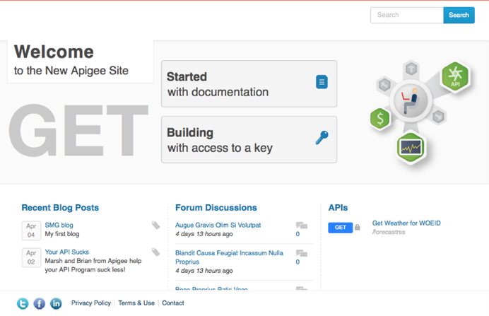
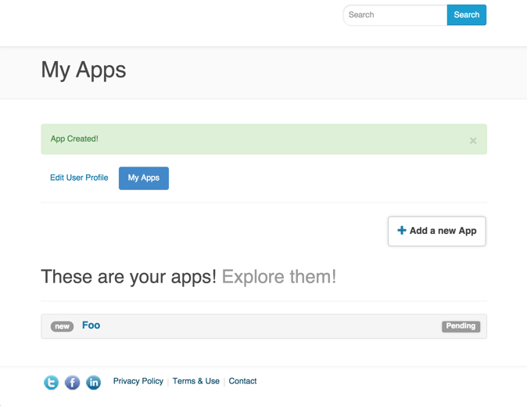
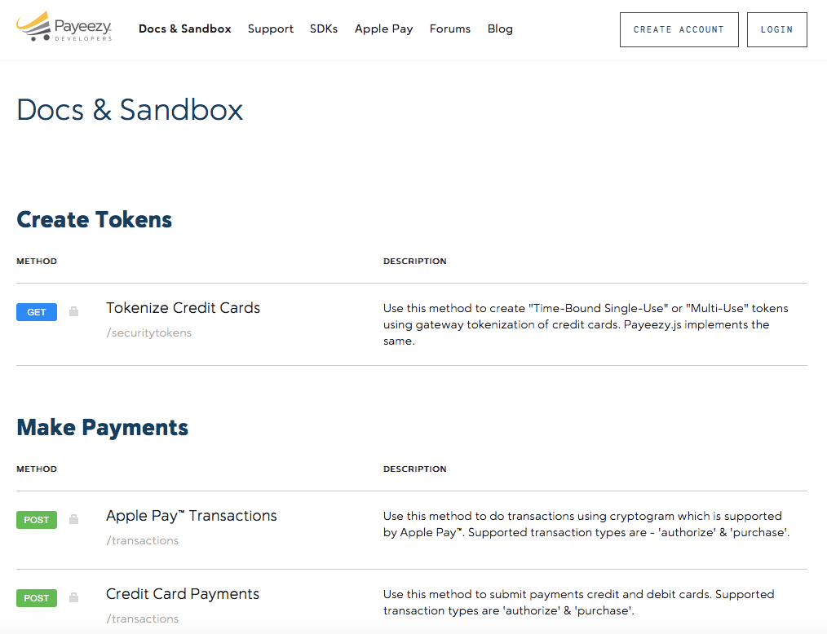
Make it Easy for Developers to Use your APIs
Automatic or Manual Registration
Self-service app key requests
Self-documenting
Reduced time to first app from 4 weeks to 6 hours.
Online Education Provider
Notes:
Main Point
Make it easy for developers to use your APIs with a secure and turnkey developer portal that gives them self-service access to your APIs, forums, blogs, sandbox, analytics, and more.
Script
Make it easy for developers to use your APIs with a secure and turnkey developer portal that gives them self-service access to your APIs, forums, blogs, sandbox, analytics, and more.
With Apigee Edge, you can deploy a custom and turnkey developer portal that provides self-service access to your APIs, api-keys, and SmartDocs. The developer portal comes with hundreds of pre-installed modules such as polls, blogs, and forums; external authorization for login, such as Google, GitHub, LDAP, and OpenId; Internationalization; Issue tracker integrations like BugHerd; Google Analytics; and more. In addition, with over 10,000 open source Drupal modules and themes available, covering a huge range of use cases, you can install and configure new add-ons to get the desired functionality, such as Jira integration, powerful workflow tools, content rating tools, and much, much more. Additionally, the developer portal is based on open source Drupal technology with a 1M+ developer community. This enables you to customize Drupal to meet your unique needs and easily find developers to augment your internal teams.
As developers participate in your API program, the analytics within Apigee Edge enable you to measure usage, adoption and engagement so you can tailor your APIs and program appropriately to meet their needs.
Leading enterprises such as First Data, Walgreens, Pearson, Equinix and many more are using the Developer Portal to make it easy for their developers to use their APIs.
Link to Wiki
https://apigeesc.atlassian.net/wiki/pages/viewpage.action?pageId=76415368
For Instance
Walgreens - launched their portal with minimal customizations on top of the out of the box portal. But on the other hand, ATT used Edge’s management APIs to build their own developer portal from scratch.
Equinix -https://developer.equinix.com/ - partner and internal . Onboard their users using an internal system and then the developers get access to dev portal via sso.
Gracenote - https://developer.gracenote.com and https://developer.ntt.com/en portals are available in both Japanese and English. They leverage the OOB i18n features.
Pearson - community.pdn.pearson.com a complete custom module built into http://developer.pearson.com/ . A nice custom built app gallery http://developer.pearson.com/product-showcase with capabilities like “Related Showcases” etc. done with Drupal’s powerful taxonomy feature. Custom feature like Bookmarks for contents.
First Data in their portal has different flows for customer on boarding and merchant on boarding. They have also built a custom flow for Certifying the apps which are getting registered in their dev portal.
Whatever flow you want to have for authentication :
EE - user is registered only by their support in their own support portal and then the details sent to the user
Gracenote - Enabled social login on their dev portal. Developers can choose to Login via facebook at the registration page.
First Data - included security questions as part of registration
Associated Press/Pitney Bowes wants to include their internal customer IDs generated from different systems while customer registers. Registration flow customized to make a call to their internal systems to generate/retrieve customer IDs to include in custom attributes of developer.
Vantiv - App certification process : Vantiv uses a App certification process to qualify and graduate developers from a sandbox environment to production. Today, it is a manual and high touch process. Vantiv wanted to move to a more self service model and therefore automate the app certification process. The new model is that the developers takes tests which are logged, and when they pass the test, they automatically are approved to move their apps to production. The extensibility of our developer portal in addition to the inbuilt rules engine allowed us to build this custom workflow out resulting in a highly self service workflows that the customer finds extremely helpful.

Slide 49
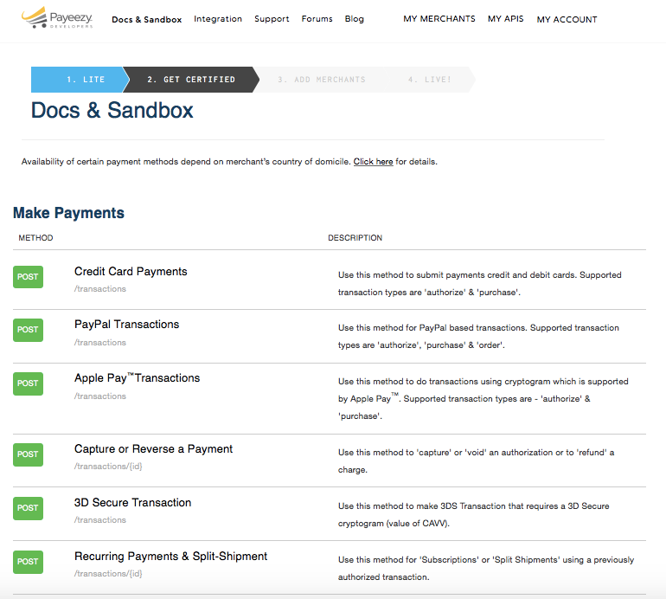
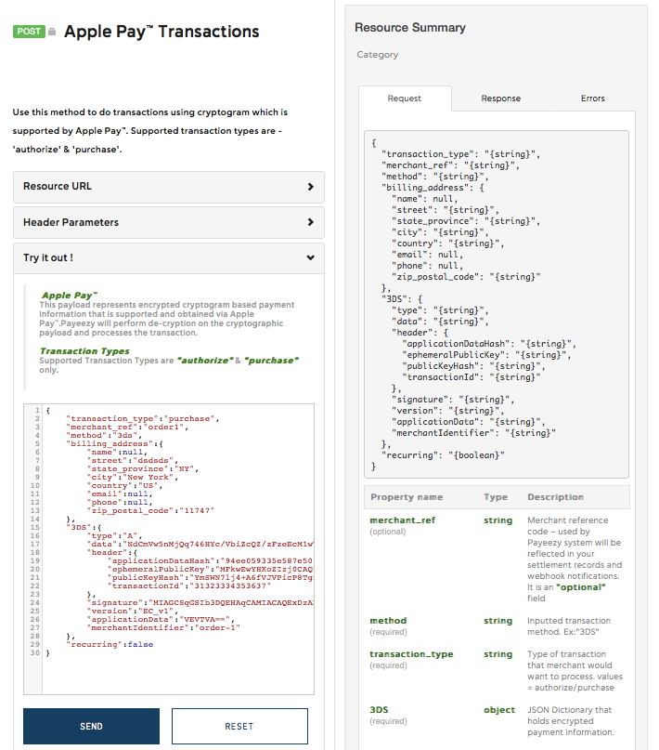
Testable, Automatable, OpenAPI Spec based - Documentation
SmartDocs
Notes:
Main Point
Make it easy for developers to use your APIs with a secure and turnkey developer portal that gives them self-service access to your APIs, forums, blogs, sandbox, analytics, and more.
Script
Make it easy for developers to use your APIs with a secure and turnkey developer portal that gives them self-service access to your APIs, forums, blogs, sandbox, analytics, and more.
With Apigee Edge, you can deploy a custom and turnkey developer portal that provides self-service access to your APIs, api-keys, and SmartDocs. The developer portal comes with hundreds of pre-installed modules such as polls, blogs, and forums; external authorization for login, such as Google, GitHub, LDAP, and OpenId; Internationalization; Issue tracker integrations like BugHerd; Google Analytics; and more. In addition, with over 10,000 open source Drupal modules and themes available, covering a huge range of use cases, you can install and configure new add-ons to get the desired functionality, such as Jira integration, powerful workflow tools, content rating tools, and much, much more. Additionally, the developer portal is based on open source Drupal technology with a 1M+ developer community. This enables you to customize Drupal to meet your unique needs and easily find developers to augment your internal teams.
As developers participate in your API program, the analytics within Apigee Edge enable you to measure usage, adoption and engagement so you can tailor your APIs and program appropriately to meet their needs.
Leading enterprises such as First Data, Walgreens, Pearson, Equinix and many more are using the Developer Portal to make it easy for their developers to use their APIs.
Link to Wiki
https://apigeesc.atlassian.net/wiki/pages/viewpage.action?pageId=76415368
For Instance
Walgreens - launched their portal with minimal customizations on top of the out of the box portal. But on the other hand, ATT used Edge’s management APIs to build their own developer portal from scratch.
Equinix -https://developer.equinix.com/ - partner and internal . Onboard their users using an internal system and then the developers get access to dev portal via sso.
Gracenote - https://developer.gracenote.com and https://developer.ntt.com/en portals are available in both Japanese and English. They leverage the OOB i18n features.
Pearson - community.pdn.pearson.com a complete custom module built into http://developer.pearson.com/ . A nice custom built app gallery http://developer.pearson.com/product-showcase with capabilities like “Related Showcases” etc. done with Drupal’s powerful taxonomy feature. Custom feature like Bookmarks for contents.
First Data in their portal has different flows for customer on boarding and merchant on boarding. They have also built a custom flow for Certifying the apps which are getting registered in their dev portal.
Whatever flow you want to have for authentication :
EE - user is registered only by their support in their own support portal and then the details sent to the user
Gracenote - Enabled social login on their dev portal. Developers can choose to Login via facebook at the registration page.
First Data - included security questions as part of registration
Associated Press/Pitney Bowes wants to include their internal customer IDs generated from different systems while customer registers. Registration flow customized to make a call to their internal systems to generate/retrieve customer IDs to include in custom attributes of developer.
Vantiv - App certification process : Vantiv uses a App certification process to qualify and graduate developers from a sandbox environment to production. Today, it is a manual and high touch process. Vantiv wanted to move to a more self service model and therefore automate the app certification process. The new model is that the developers takes tests which are logged, and when they pass the test, they automatically are approved to move their apps to production. The extensibility of our developer portal in addition to the inbuilt rules engine allowed us to build this custom workflow out resulting in a highly self service workflows that the customer finds extremely helpful.

Slide 50
Edge
Design
Monetize
Develop
Analyze
Secure
Edge
Monitor
Publish
Scale

Slide 51
Operational Excellence
Region
Region
Pod
Pod
Pod
Pod
Traffic Isolation Independent Scaling
API Processing
Data
Low Latency
Management
UI, API Definitions, Users, Roles, System Configurations
Simpler Administration
Centralized control, decentralized development
Multi-tenant architecture
Notes:
Main Point
Apigee Edge’s multi-tenant architecture enables you to exercise centralized control while supporting decentralized development across multiple teams.
Script
As your digital business evolves, you will need to define, refine, and deploy APIs. Managing the API software development lifecycle across a geographically distributed teams while operating at Internet scale presents challenges. Apigee has optimized the API SDLC by providing a set of APIs and a UI based on these APIs that greatly simplifies defining, refining, and deploying APIs. There are a few key challenges to address:
Cloud scale deployment
Deploying code to multiple servers in a geographically distributed system is challenging, and requires planning, process, and tools. Edge simplifies deployment through an API first philosophy and centralized management – effectively a single point of contact – and through its distributed architecture. When deploying an API into an environment, Edge automatically pushes those new and/or updated APIs to the API runtime server.
Zero downtime deployment
Maintaining dial-tone continuity while upgrading proxies doesn’t happen without a deep understanding of global, cloud-scale deployment and the consequences of dropped transactions. Edge is designed to gracefully transition to newer versions of existing APIs without disrupting in-flight traffic. This ensures that inbound traffic is not rejected during deployment of a new revision. Edge will gradually transition to the new revision; in-flight APIs will continue to use the previous revision. API calls received after the new revision has been deployed will be routed to the new revision. Once the in-flight queue has been emptied, the previous revision will be disabled.
Independent Scaling
In the web world, you are likely to face significant spikes in API traffic – both planned and unplanned. You need the ability to handle these order of magnitude spikes without requiring complex and time-consuming procedures. Apigee Edge is designed to linearly scale at all layers of the software. Furthermore, Apigee Edge enables you to temporarily add additional capacity to support known traffic patterns (e.g. Black Friday shopping, sports season, etc.), which can then be dissolved when the need no longer exists.
Multiple revision management
With Edge, API developers can maintain multiple environments within the same infrastructure. This greatly simplifies enhancing APIs in a safe, secure manner. Furthermore, switching between revisions in an environment is trivial and can be accomplished via an API call or the management UI.
Updates
The API tier is one of the most critical link in the entire value chain between the users’ apps and your business. Therefore, all updates made to either add new capabilities, or to fix vulnerabilities within the Apigee Edge platform are applied in an orchestrated manner without bringing down the service for any customers
Multi-Region Deployment
Among other factors, great in-app user experience depends heavily on fast response times, and the best way to achieve that is to minimize the path between the client apps and the APIs. By enabling a multi-region deployment of the Edge platform across multiple geographies, you benefit from lower latencies for your API traffic because API requests are automatically routed to the closest data center from the origin of those requests.
Isolation & Efficiency
The deployment architecture is designed to ensure process and data isolation of the API runtime traffic for each customer such that it is not affected by API traffic from other customers deployed in the Apigee cloud. At the same time, each of the software component that makes up the Edge platform is deployed and managed within administrative groups to ensure maximum resource utilization and automated monitoring and management.
Distributed Teams
Your central IT team can exercise data privacy or other controls centrally, while enabling different teams to follow their own software development lifecycle to build their APIs. Your central IT team continues to maintain complete visibility into complete API footprint across your company. Additionally, In a fast changing digital world, this capability makes it very easy to bring on a new team – the incremental costs are minimal and teams can fail fast or succeed fast when building new APIs.
Individually these challenges are difficult to overcome, and would require complex, expensive, and/or customized solutions. Apigee recognizes these features as vital to the success of deployment and operation of an API program and has addressed these challenges directly in the product.
Link to Wiki
https://apigeesc.atlassian.net/wiki/display/SEP/Centralized+Management%2C+Global+Deployment
https://apigeesc.atlassian.net/wiki/display/SEP/Centralized+Control+with+Decentralized+Development
For Instance
Equinix – http://www.lightreading.com/data-center/cloud-strategies/equinix-unifies-the-cloud-with-apigee-apis/d/d-id/712908 - With Apigee Edge, Equinix customers can connect to APIs deployed in any of the 17 cloud service providers Equinix hosts.
SAP - http://scn.sap.com/community/labs/blog/2014/11/04/api-economy-and-mash-up-programming - SAP has chosen Apigee Edge as the API management platform on which to host APIs that expose existing SAP HANA functionality. Of the many benefits provided by Apigee Edge, the ability to operate a cloud scale API program with centralized management and global deployment was a clear benefit.
Target - http://apigee.com/about/resources/innovator-spotlights/target-meeting-new-customer-expectations-apis - Target has created a resilient, scalable API program to help realize a seamless, multi-channel experience. Developers use these APIs to build innovative, customer-facing mobile apps.

Slide 52
Deploy in the Public or Private Cloud
3,000⁺ servers
10 regions
(Google Cloud Platform)
Private Cloud Leading Telco
Edge Cloud
1⁺ Billion calls / month
~20 ms average latency
>99.999% API availability
~2.7 billion transactions / day
Multi-Datacenter Deployment
Private Cloud = Public Cloud
Notes:
Main Point
Apigee Edge offers the same benefits whether you choose to run it in our public cloud or your private cloud.
Script
Apigee Edge is available both as a SaaS option and also to be hosted on your private cloud. You get all the benefits from Apigee Edge whether you run it in our public cloud or if you choose to run it on your private cloud.
As a private cloud customer, you benefit from all the performance, scale, and operational rigor that Apigee Edge has gone through in our public cloud. The private cloud offering uses the same codebase as our public cloud offering. Hence it has the same roadmap as the public cloud offering and is treated as a first-class citizen. This means that you have the flexibility to start with the public cloud and then move to private cloud if your business needs change in the future. You won’t need to retrain your teams and everything you’ve developed on the SaaS version can be easily ported onto the private cloud offering.
Whether you choose to use the public cloud or private cloud, you’ll enjoy the same smooth setup of Edge, silent installation for automation, flexible environment management, cloud grade design, access to best practices, and more.
Link to Wiki
https://apigeesc.atlassian.net/wiki/display/SEP/THEME+%3A+Public+Cloud+%3D+Private+Cloud
For Instance
Apigee Edge hosted by Apigee is operated for unprecedented scale and performance. Some data points :
7 Regions, 19 Availability zones
3000+ servers
~1/2 Billion transactions / day
>99.9% API availability
~20 ms average latency
Monitoring tools integration
Cross Datacenter failover Security

Slide 53


High Performance. Always.
Scale with state and without compromising latency
Edge
Clients
Targets
Traffic
Analytics
Data Types
OAuth Tokens
Cached data
Traffic Metrics
Requirements
Fast Lookup
& Eventual Consistency
Dimensional
& Structured Analysis
Notes:
Main Point
Apigee Edge is the only API Management public cloud provider that can scale with state.
Script
When your business sees increased API traffic – whether planned due to a campaign or new initiative, or unplanned due to unexpected increase in engagement, your APIs need to continue to be just as responsive at the increased scale so that the user experience is not impacted.
This is easier to do with systems that are stateless – they are easier to scale. However, when you have to maintain state, scaling is harder because you need to be performant and not latency. In most cases, it can take a long time to realize that there’s a problem with the chosen platform that cannot scale and it takes an even longer time to rectify the problem. During this time, you risk losing customers and partners. Your brand gets tarnished, and you can suffer loss in revenue. And it takes a lot more effort and higher costs to acquire those customers back.
New architecture built for the cloud, scale web scale. Scale can go order of magnitude jumps really quickly.
Apigee Edge is the only API Management public cloud provider that can scale with state. Even if you’re using Apigee Edge in your private cloud, you can realize a lot of infrastructure efficiency and hence cost savings while scaling.
Link to Wiki
https://apigeesc.atlassian.net/wiki/display/SEP/THEME+%3A+State+@+Scale
For Instance
Public Cloud: A leading media company was able to scale their API calls from 400M to 3.1B (~8x growth in 6 months) whilst maintaining the same latency as needed. More details: 100+APIs. 700+ Apps .1,200+ avg. TPS. 9+ TB analytics data. Also the customers’ 8x growth was achieved with only 40% increase in infrastructure provisioned. (See separate slide)
Public Cloud: Apigee also processed over 100B API calls in 2014 for our SaaS customers and some of our private cloud customers processing 1B calls a month. This is an example of how Apigee's architecture is meant to support state @ scale. (See Separate Slide)

Slide 54
Zero Downtime Deployment
Deploy new revisions without disrupting in-flight API traffic
Rev. 2 deployed
Rev. 2
API Traffic
Rev. 1
Time
Notes:
Main Point
Apigee Edge enables you to deploy new versions of your APIs without disrupting in-flight API traffic.
Script
The rapid pace of change means that your APIs will also evolve. Consumers rely on apps powered by your APIs to complete their tasks. Your business partners rely on your APIs to conduct their business. APIs that are available as they evolve and improve drive additional revenue – the risks of APIs going down do more harm than just revenue loss – they affect your brand, lead developer defection, damage the customer perception, and more.
Apigee Edge is designed to gracefully transition to newer versions of existing APIs without disrupting in-flight traffic. This ensures that inbound traffic is not rejected during deployment of a new revision. Edge will gradually transition to the new revision; in-flight APIs will continue to use the previous revision. API calls received after the new revision has been deployed will be routed to the new revision. Once the in-flight queue has been emptied, the previous revision will be disabled.
Apigee Edge enables you to easily deploy new versions of your APIs without disrupting in-flight API traffic so you can keep your customers engaged, partners happy, and business growth robust.
Link to Wiki
https://apigeesc.atlassian.net/wiki/display/SEP/Zero+Downtime+Deployment
For Instance
https://blog.apigee.com/detail/make_your_customers_digital_disruptors_not_digitally_disrupted - Trend 5 - The business of applications: Software as a core competency in a digital world
Twitter - http://www.cnet.com/news/the-cost-of-twitter-downtime/ - As Twitter grows its ad business and user base, downtime for the site can mean business lost for publishers, marketers, and self-promoters.
Facebook - http://blog.catchpoint.com/2014/06/19/widespread-effects-facebooks-latest-outage - The effects of an outage at Facebook were felt by both users and other sites that rely on Facebook APIs.

Slide 55
Design
Monetize
Develop
Analyze
Secure
Edge
Monitor
Publish
Scale
Notes:
Let’s talk about analysis and monitoring features of Edge.

Slide 56
Gain visibility into the entire Digital Value Chain
Complete visibility – from app end to backend
Automatically and continuously collect all data about your API traffic out of the box
Relevant, Actionable and Extensible Dashboards, Tools & Custom Reports
User
App Analytics
Developer Analytics
API Analytics
Backend
App Performance
App Usage
API Performance
Filter by app version, device, platform, OS, etc.
Top Developers
Developer Engagement
Top API Users
Top Products
Top Apps
API Traffic Patterns
API Performance
Geo location
Anomalies
Multiple metrics – traffic, response times, errors, data exchange, etc.
Notes:
Main Point
Apigee Edge provides complete visibility into the entire digital value chain – from app end to the back end
Script
The digital value chain stretches all the way from the user to the back end services. Digital requires you to know how you’re doing at every stage of the value chain. Apigee Edge provides complete visibility into the entire digital value chain – from the app end to the back end.
Apigee Edge automatically and continuously collects analytics data from all API traffic. As a result, you do not need separate tools for API analytics, saving you costs in terms of resources, infrastructure and on-going maintenance. Since the data collection is continuous, you can see meaningful API trends and API failures that may not be apparent when analytics are measured at coarse aggregation intervals. In fact, Apigee Support uses the same analytics data to help resolve customer issues.
Apigee Edge provides complete visibility into the health and performance of your APIs. Apigee Edge provides a number of out of the box charts that help you measure and monitor traffic, performance, latency, errors and more. The out of the box charts also reduce downtime – you can quickly identify potential bottlenecks with target endpoints based on the observed API performance and usage trends. Using this information, you can make changes to their target endpoints and avoid potential downtime.
Apigee Edge enables you to improve the productivity of your developers consuming your APIs by using the OOTB charts to identify issues related to latencies or errors, and proactively reaching out to those developers to help them properly consume APIs. This results in consuming developers fixing their apps quickly with the help of the API team rather than doing it on their own.
Apigee Edge provides complete flexibility with self-service custom reports. You can quickly adapt to changing business and customer needs by extending the core analytics to capture additional data from your APIs and create powerful custom analytics reports using the self-service interface. Edge Analytics allows you to create custom metrics and dimensions and use them in any report, custom report or analytics API. You can use virtually any attribute that describes traffic to create custom metrics and dimensions. This means you can use more than 500 variables available in the gateway, or extract them from the API request, response, request payload or response payload. You can use these custom variables in default reports such as Investigate Anomalies or in Custom Reports
While Apigee Edge collects a lot of API data, we recognize that you often also have a need to combine this data with other operational and business data obtained by other means. Apigee Edge enables you to create custom queries against raw traffic data using RESTful APIs. You have full flexibility to obtain Apigee collected metrics using automated scripts as-and-when needed. Without this capability, you would need to understand the underlying data schema, use database specific SQL scripts, etc. to obtain the raw traffic data that you need. As a result of these Analytics Apis, you can reduce data extraction costs and easily integrate with existing reporting, analytics, and visualization tools. This reduces the time, effort, and costs of making Apigee Edge to work with existing enterprise tools and initiatives.
In addition, Apigee Edge provides analytics for your mobile developers enabling them to monitor the usage, performance, and crashes and errors in their mobile apps.
This end to end approach provides unprecedented information about how your entire value chain is interacting with your services.
Link to Wiki
https://apigeesc.atlassian.net/wiki/display/SEP/Out-of-the-Box+Charts+for+API+Performance+and+Usage
https://apigeesc.atlassian.net/wiki/display/SEP/Automatic+Continuous+Data+Collection+from+all+API+Traffic
https://apigeesc.atlassian.net/wiki/pages/viewpage.action?pageId=76415356
https://apigeesc.atlassian.net/wiki/display/SEP/Apigee+APIs+to+Create+Custom+Queries+Against+Raw+Traffic+Data
For Instance
A customer had a 7 minute outage and didn't even know about that outage from the analytics reports because the data they collected was done done at a coarser granularity and aggregated. Using Apigee Edge, we would have known about the outage based on the continuous analytics that are collected, which would have shown up in the out-of-the-box dashboards. The customer may be having multiple outages like this without their knowledge, which may result in customer satisfaction going down and may even impact revenue.
Another data point is Apigee’s own usage of these API analytics in supporting our Cloud customers. Using this capability, Apigee was able to collect metrics on over 100B+ API calls that happened in 2014 - the Apigee Support team did not have to do anything to collect these metrics, but found this analytics data to be very valuable in resolving customer issues.
Large retailer encountered a situation where users of their mobile app had to re-login frequently. This was a result of an inadvertent change to the TTL of the refresh token from 60 days to 2 hours. Using the Analytics APIs, the customer and Apigee GSC were able to run queries that helped them get Refresh Token TTL information given respective Access Token IDs and identify this misconfiguration.
First Data uses Analytics APIs to measure the total revenues driven by each retailer partner that's using their Payeezy APIs for Apple Pay. Immediately following the launch of Apple Pay, First Data was able to measure the success of the Apple Pay program across various retailers by capturing the transaction amounts from the API message payload and generating analytics reports in Apigee without any custom development.
After launching their APIs for developers, Sony Mobile wanted to measure the success of their API program by tracking daily growth in adoption of their APIs by developers and apps. They used the Analytics APIs to run their queries from a Node.js application that collects traffic data for each API, developer, and app from the launch of those APIs to measure the overall growth and individually by each developer and app. This data is compiled and reported up to their executives on a daily basis.

Slide 57
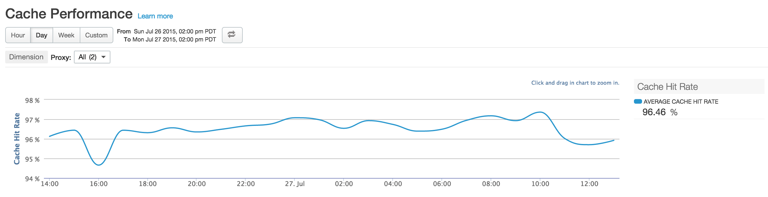
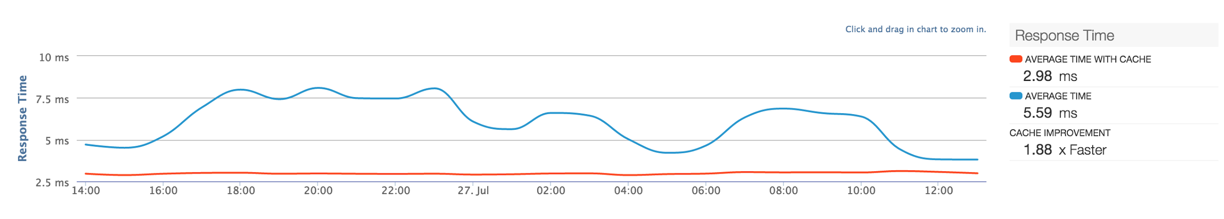
Improve API Response Times
In-memory, persistent response, and distributed, key / value map cache
Notes:
Main Point
Apigee Edge enables you to improve API response times with in-memory, persistent response, and distributed, key / value map caching
Script
Customer expectations of responsiveness in their digital experience are increasing. As your digital experiences are powered by APIs, its critical that your APIs deliver low latency responses, without imposing additional load on systems of record. Response caching is no longer enough to solve this problem, especially since your APIs will change rapidly to keep pace with customer expectations. You need the capability to not only cache, but re-use that cache is different ways.
Apigee Edge enables you to improve a better digital experience with in-memory, persistent response, and distributed, key / value map caches. You can use these caches to store data that would otherwise be provided by target service. With caching turned on, you can improve API performance, reduce latency, and minimize target server load and footprint. In addition, with caching, you can improve the client experience by optimizing the client-specific request and response payloads, ensuring that the cached data is close to stationary and mobile users, and enabling client platform specific capabilities such as pagination.
With caching turned on in Apigee Edge, you can improve customer satisfaction AND reduce infrastructure costs.
Link to Wiki
https://apigeesc.atlassian.net/wiki/display/SEP/Caching
For Instance

Slide 58
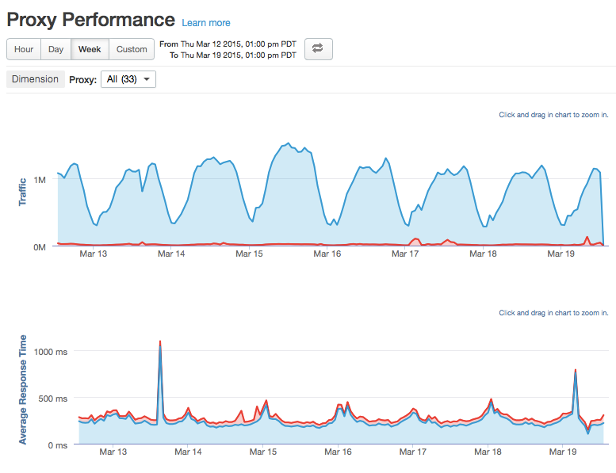
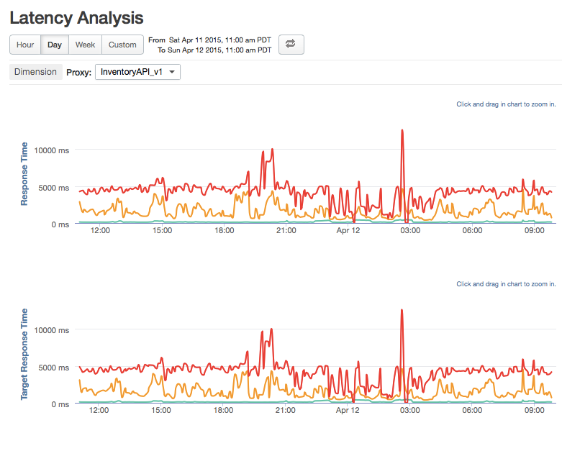
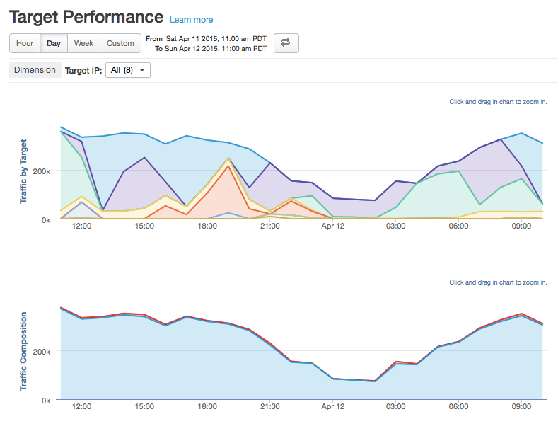
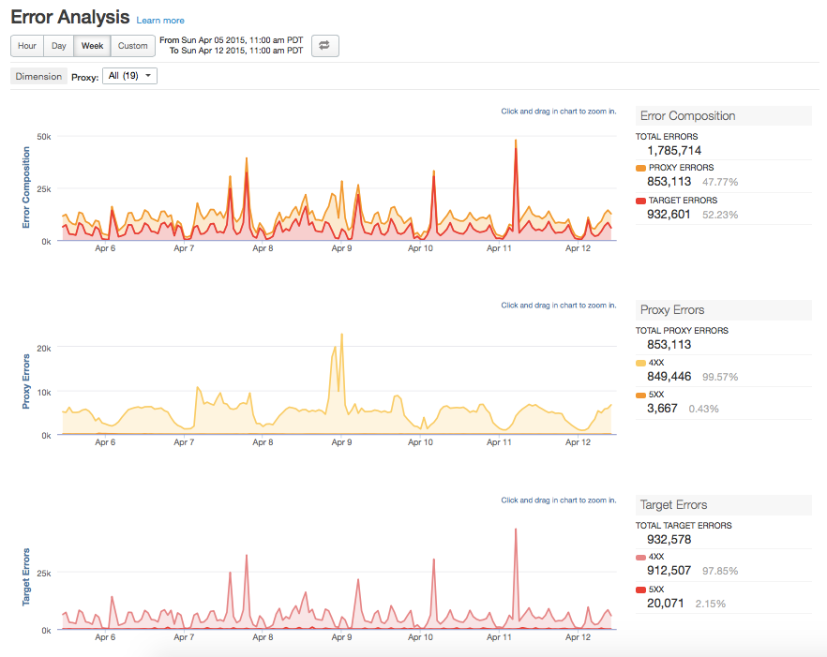
Build APIs Faster
Proxy Performance
Latency Analysis
Target Performance
Error Analysis
Many ready to use out of the box charts and reports

Slide 59
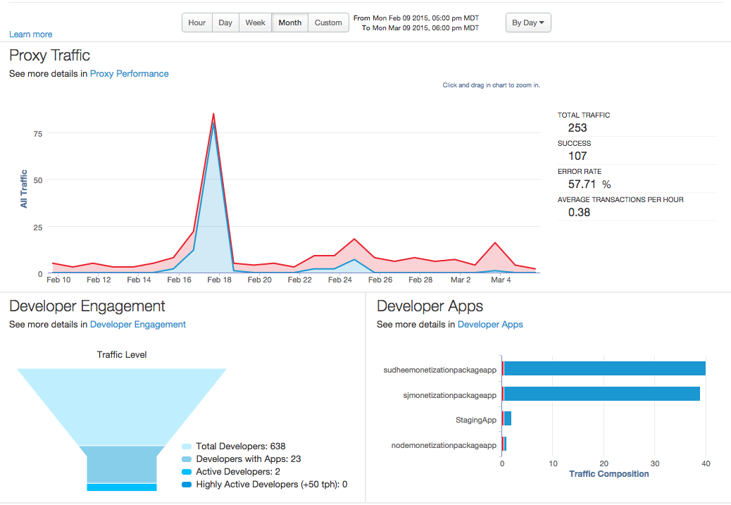
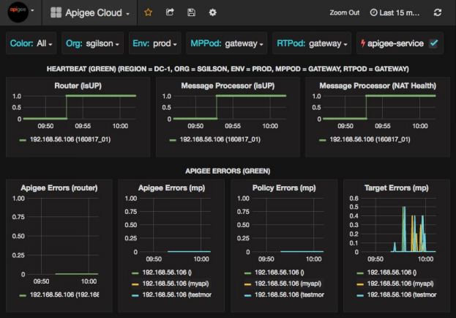
Analyze and Improve APIs
What YOU see
What WE see
Automatically and continuously collect all data about API traffic out of the box

Slide 60
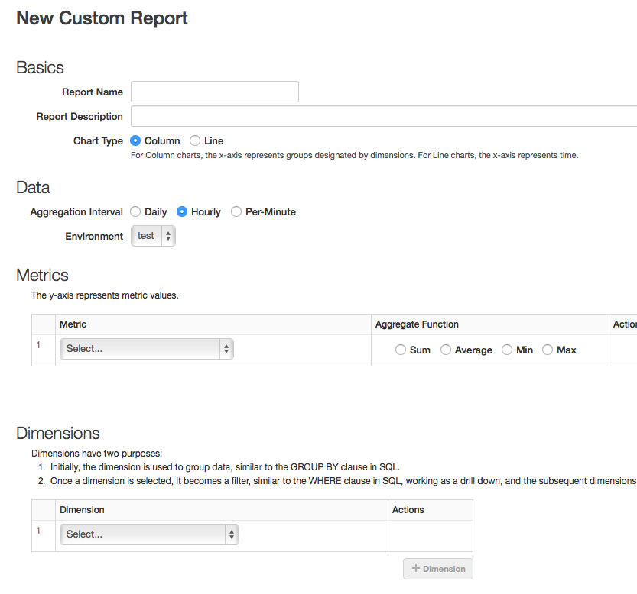
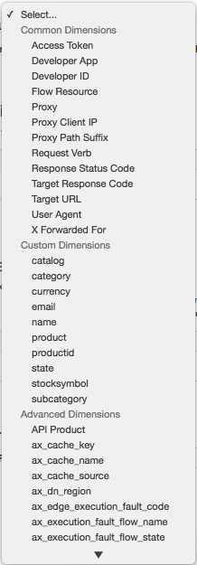
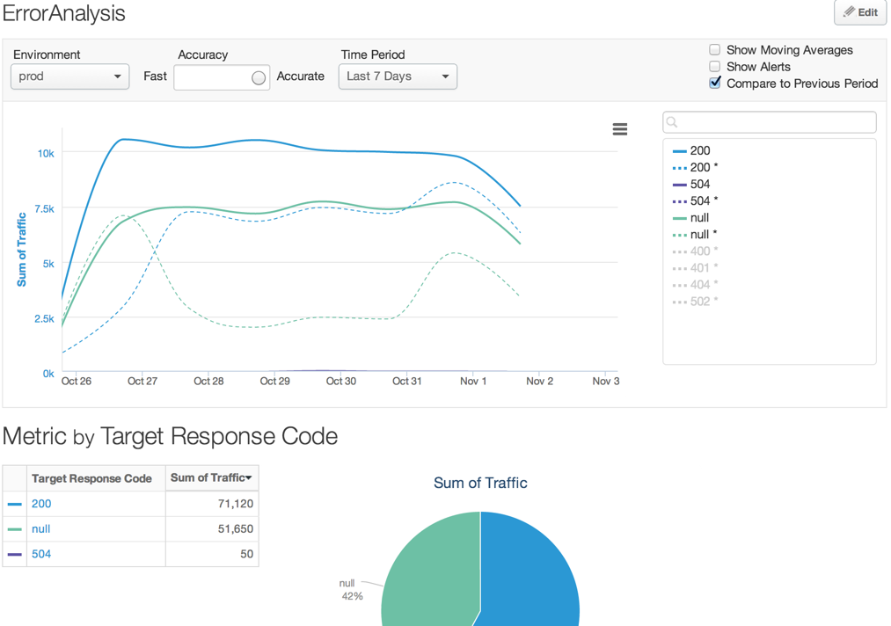
Build your Own Reports
Self-service custom reports: Define custom metrics, dimensions, queries, reports, and dashboards using virtually any attribute that defines traffic.
500+ Gateway Variables
Reports
API Request
API Response
Metrics &
Dimensions
Custom
Reports
Request Payload
Analytics API
Response Payload
Notes:
Main Point
Apigee Edge provides complete flexibility with self-service custom reports.
Script
Apigee Edge provides complete flexibility with self-service custom reports. You can quickly adapt to changing business and customer needs by extending the core analytics to capture additional data from your APIs and create powerful custom analytics reports using the self-service interface. Edge Analytics allows you to create custom metrics and dimensions and use them in any report, custom report or analytics API. You can use virtually any attribute that describes traffic to create custom metrics and dimensions. This means you can use more than 500 variables available in the gateway, or extract them from the API request, response, request payload or response payload. You can use these custom variables in default reports such as Investigate Anomalies or in Custom Reports
Link to Wiki
https://apigeesc.atlassian.net/wiki/pages/viewpage.action?pageId=76415356
For Instance
First Data uses Analytics APIs to measure the total revenues driven by each retailer partner that's using their Payeezy APIs for Apple Pay. Immediately following the launch of Apple Pay, First Data was able to measure the success of the Apple Pay program across various retailers by capturing the transaction amounts from the API message payload and generating analytics reports in Apigee without any custom development.

Slide 61
Easily Integrate API Analytics with Enterprise Tools
Create custom queries against raw traffic data.
Over 120 query APIs
Metric
Dimension
Aggregation type
Interval
Ordering
Time duration
Filter
Requests by API
curl -v -u {email}:{password} "https://api.enterprise.apigee.com/v1/o/{org}/e/{env}/stats/apis?
select=sum(message_count)&timeRange=03/01/2016%2000:00~04/01/2016%2000:00"
Avg. Total Response Time by API
curl -v -u {email}:{password} "https://api.enterprise.apigee.com/v1/o/{org}/e/{env}/stats/apis?
select=avg(total_response_time)&timeRange=03/01/2016%2000:00~04/01/2016%2000:00"
Max. Total Response Time By API
curl -v -u {email}:{password} "https://api.enterprise.apigee.com/v1/o/{org}/e/{env}/stats/apis?
select=max(total_response_time)&timeRange=03/01/2016%2000:00~04/01/2016%2000:00"
Min. Total Response Time By API
curl -v "https://api.enterprise.apigee.com/v1/o/{org}/e/{env}/stats/apis?
select=min(total_response_time)&timeRange=03/01/2016%2000:00~04/01/2016%2000:00"
Avg. Target Response Time By API
curl -v -u {email}:{password} "https://api.enterprise.apigee.com/v1/o/{org}/e/{env}/stats/apis?
select=avg(target_response_time)&timeRange=03/01/2016%2000:00~04/01/2016%2000:00"
Notes:
Main Point
Apigee Edge provides customers the ability to create custom queries using Analytics APIs against raw traffic data.
Script
Apigee collects a lot of analytics out-of-the-box and provides you the ability to collect custom analytics. This data is very useful independently, but often also have a need to combine this data with other operational and business data obtained by other means. This capability of being able to create custom queries against raw traffic data using RESTful APIs gives you full flexibility to obtain Apigee collected metrics using automated scripts as-and-when needed. Without this capability, you would need to understand the underlying data schema, use database specific SQL scripts, etc. to obtain the raw traffic data that you need.
As a result of these Analytics Apis, you can reduce data extraction costs and easily integrate with existing reporting, analytics, and visualization tools. This reduces the time, effort, and costs of making Apigee Edge to work with existing enterprise tools and initiatives.
Link to Wiki
https://apigeesc.atlassian.net/wiki/display/SEP/Apigee+APIs+to+Create+Custom+Queries+Against+Raw+Traffic+Data
For Instance
After launching their APIs for developers, Sony Mobile wanted to measure the success of their API program by tracking daily growth in adoption of their APIs by developers and apps. They used the Analytics APIs to run their queries from a Node.js application that collects traffic data for each API, developer, and app from the launch of those APIs to measure the overall growth and individually by each developer and app. This data is compiled and reported up to their executives on a daily basis.

Slide 62
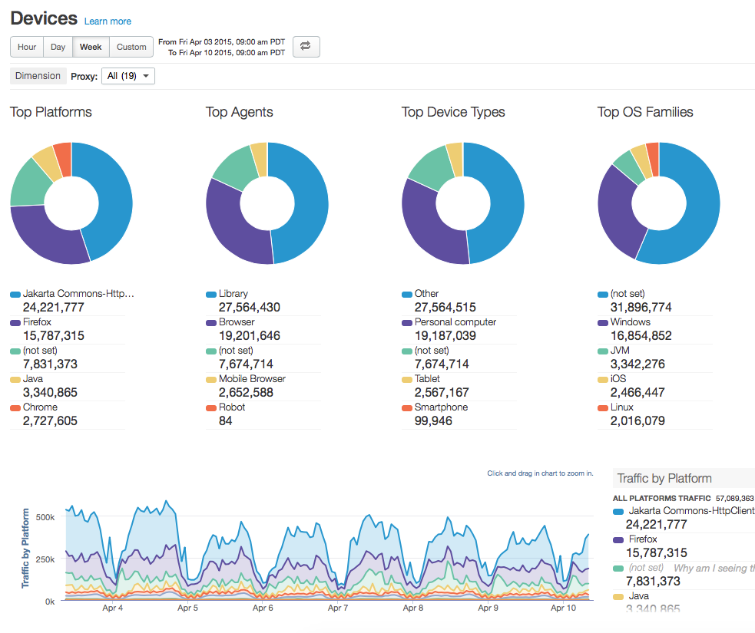
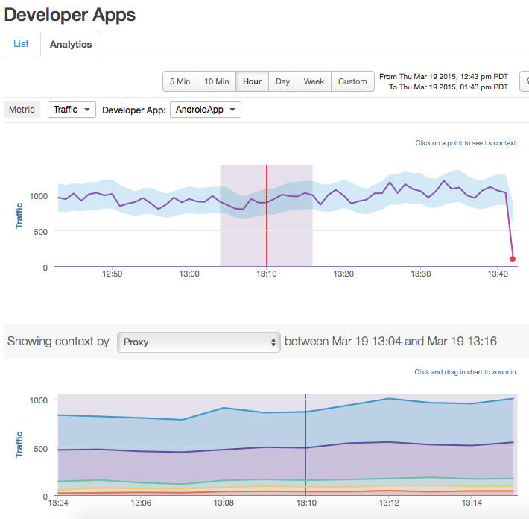
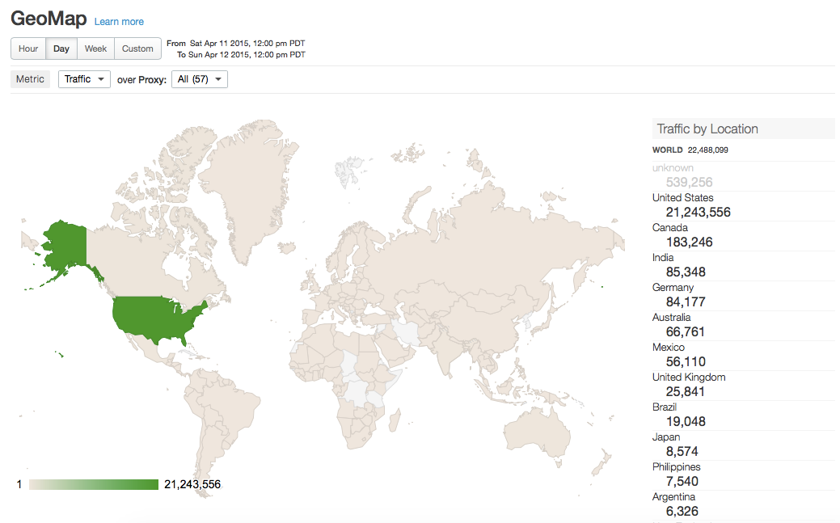
Measure & Grow the API Program
Developer Apps
Geomap
Devices

Slide 63
Design
Monetize
Develop
Analyze
Secure
Edge
Monitor
Publish
Scale

Slide 64

Monetize APIs: Any Partner, Any Business Model
Flexible rate plans, internationalization support, usage tracking, limits and notifications
Revenue-sharing models (API provider charges developer)
Fee-based models (API provider charges developer)
Freemium models
Fixed
Transaction
Duration
Flexible
Transaction Volume
Quantity
Custom Attribute
Hybrid (flat fee + fixed & flexible)
Hybrid
Revenue / Volume Bands
One-time
Subscription
Advance / Arrears
Pro-rated / Full amount
Notes:
need script for monetization

Slide 65
Apigee Edge
Design Design first. Document Smart. Full support for Swagger 2.0
Monetize
Flexible rate plans
Internationalization support
Usage tracking
Limits and notifications
Develop
Configuration: Over 30 ready-to-use & configurable policies
Code: Built-in support for Node, JavaScript and
Java extensibility
BaaS
Analyze
Complete visibility– from app end to backend
Automatically and continuously collect all API-traffic data out of the box
Secure
End-to-end security
Threat protection
Access control
Simple OAuth implementation for your APIs
PCI and HIPAA compliance
Edge
Monitor Centralized control, decentralized development
Multi-tenant architecture
Billions of API calls, including large spikes
Publish
Turnkey developer portal
Scale
Self-service
State @ scale
Flexible deployment
Notes:
Main Point
Apigee Edge addresses your needs across the entire API lifecycle
Script
Apigee Edge addresses your needs across the entire API lifecycle – from designing APIs to building them to scaling your API program and finally monetizing your APIs. Apigee Edge satisfies a number of your needs that would otherwise be very time consuming and costly to build and operate at scale.

Slide 66
Apigee Edge - Standard Deployment Models

Slide 67
Apigee Edge Public Cloud (SaaS)
Apigee Edge
API Analytics
Internal / Partner Developers
ESB / SOA
Developer Portal
Legacy Applications
Load Balancer / Security Gateway (e.g. F5, Nginx)
Http Endpoints
Mobile App, Web App and Partner Apps
API Gateway
Http Endpoints
http(s) endpoints
ESB
ESB
Micro
Microservices
Cloud Applications (e.g. Salesforce)
Microgateway pulls configurations & pushes analytics
Edge Microgateway(s)
Internal Apps
Internal Apps
TLS/SSL
INTERNET
DMZ
ENTERPRISE

Slide 68
Apigee Edge Private Cloud (On-premises)
Apigee Edge
ESB / SOA
Legacy Applications
Internal / Partner Developers
API Analytics
Http Endpoints
Http Endpoints
http(s) endpoints
Mobile App, Web App and Partner Apps
Load Balancer / Security Gateway (e.g. F5, Nginx)
Internal Apps
Developer Portal
API Gateway
ESB
Cloud Applications (e.g. Salesforce)
ESB
Micro
Microservices
Microgateway pulls configurations & pushes analytics
Edge Microgateway(s)
INTERNET
DMZ
ENTERPRISE
TLS/SSL

Slide 69
Apigee Edge Microgateway
Management Interface
Analytics
Developer Portal
Core Services
Mobile, Web Applications
API
Apigee Edge
API
INTERNET
ENTERPRISE
Download configuration at bootstrap
Push Analytics to Edge
Backend
API
Edge Microgateway(s)
Internal Apps, Microservices
Throttle (Spike Arrest)
Quota
OAuth 2.0
API Key
Custom Plug-ins
Direction of API call
Async

Slide 70
Resources
Customers: https://apigee.com/about/customers
Point of View Materials: https://apigee.com/about/resources
Apigee Blogs (business and technical): https://apigee.com/about/blog
API Chronicle (monthly newsletter) : sign up at http://www.apigee.com
Social Media: YouTube Channel Twitter: @Apigee
Docs: http://docs.apigee.com
Apigee Community: https://community.apigee.com

Slide 71
Thank you!

